Slide 1
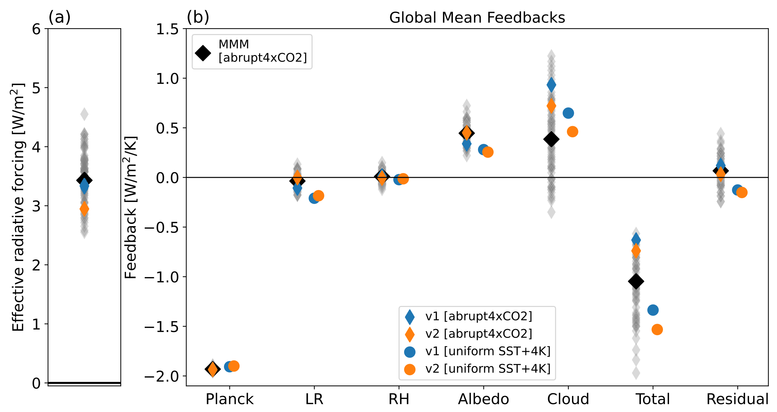
Causes of reduced climate sensitivity in E3SM from version 1 to version 2
Science Question
What causes the reduced global temperature response to increased carbon dioxide (effective climate sensitivity; ECS) from E3SM version 1 to version 2?
What are the dominant physical processes and how do they lead to the reduced ECS?
Key Accomplishments
The team uncovered that the vertical movement of air in the lower troposphere and the microscopic properties of clouds play a pivotal role in influencing the response of low-level clouds to warming.
Impact
Understanding factors impacting the global temperature response to increased carbon dioxide is crucial for reducing the uncertainty of future projections.
The discoveries shed light on unexpected impacts on warming-induced cloud response (cloud feedback) from modifications to model physics.
This study emphasizes the importance of monitoring and understanding changes in cloud feedback during model development.
Global mean (a) 2xCO2 effective radiative forcing (W/m²) and (b) radiative feedbacks (W/m²/K) from the 150 years coupled E3SMv1 (v1 [abrupt-4xCO2]), the 150 years coupled E3SMv2 (v2 [abrupt-4xCO2]), the 5 years atm-only E3SMv1 (v1 [uniform SST + 4K]) and the 5 years atm-only E3SMv2 (v2 [uniform SST + 4K]). ERFs and feedbacks from other CMIP5 and CMIP6 models are labeled as gray diamonds with the multi-model mean value labeled as the black bold diamond. The residual term is the difference between the total radiative feedback and the sum of kernel derived components. ERFs are derived using the full 150 years coupled experiments.
Qin, Y., Zheng, X., Klein, S. A., Zelinka, M. D., Ma, P.-L., Golaz, J.-C., & Xie, S. (2024). Causes of reduced climate sensitivity in E3SM from version 1 to version 2. Journal of Advances in Modeling Earth Systems, 16, e2023MS003875. https://doi.org/10.1029/2023MS003875.
Notes:
The Science
PCMDI and E3SM Scientists investigated the reduced global temperature response in increased CO2 (effective climate sensitivity; ECS) from E3SM version 1 to version 2. Their analysis pinpointed warming-induced cloud response (cloud feedback) and related processes as significant factors, elucidating the underlying mechanisms. Additionally, the team also assessed the cloud feedback, comparing with expert evaluations, and identified areas for further model development.
The Impact
The main source of uncertainty in predicting how Earth's climate responds to greenhouse gas increases comes from the unclear radiative effects of cloud changes. Delving into the details of climate models is crucial for understanding this uncertainty. In the investigation of two E3SM versions, the team uncovered that the vertical movement of air in the lower troposphere and the microscopic properties of clouds play a pivotal role in influencing the response of low-level clouds to warming. These discoveries shed light on unexpected impacts on cloud feedback arising from modifications to the model's physics and emphasized the importance of monitoring and understanding changes in cloud feedback during model development.
Summary
The effective climate sensitivity in the Department of Energy's Energy Exascale Earth System Model (E3SM) has decreased from 5.3 K in version 1 to 4.0 K in version 2. This reduction is mainly due to a weaker positive cloud feedback that leads to a stronger negative radiative feedback. Present-day atmosphere-only experiments with uniform 4 K sea surface temperature warming are used to separate the contributions of individual model modifications to the reduced cloud feedback. We find that the reduced cloud feedback is mostly driven by changes over the tropical marine low cloud regime, mainly related to a new trigger function for the deep convection scheme and modifications in the cloud microphysics scheme. The new trigger function helps weaken the low cloud reduction by increasing the cloud water detrainment at low levels from deep convection under warming. Changes to the formula of autoconversion rate from liquid to rain and an introduced minimum cloud droplet number concentration threshold in cloud microphysical calculations help sustain clouds against dissipation by suppressing precipitation generation with warming. In the midlatitudes, the increased Wegener-Bergeron-Findeisen (WBF) efficiency strongly reduces present-day liquid water and leads to a stronger negative cloud optical depth feedback. The reduced trade cumulus cloud feedback in v2 is closer to estimates from recent observational and large-eddy modeling studies but might not be due to the right physical reasons. The reduced mid-latitude cloud feedback may be more plausible because more realistic present-day mixed-phase clouds are produced through the change in the WBF efficiency.

