Slide 1
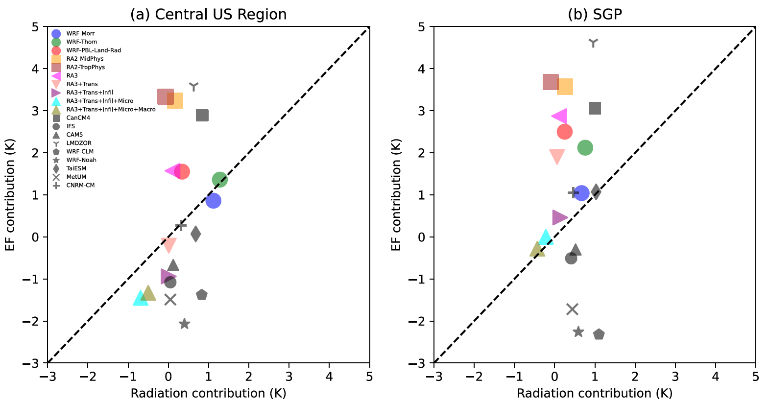
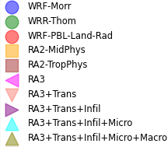
Summertime Near-Surface Temperature (T_{2m}) Biases Over the Central United States in Convection-Permitting Simulations (CPMs)
Science Question
How do biases of summertime near-surface temperature (T_{2m}) in CPMs compare to those in coarser-resolution models and do they arise from similar reasons?
What is the relationship of T_{2m} (likely through evaporative fraction: EF) to precipitation, and meso-scale convective systems (MCSs) in particular, and through which physical processes does the surface force the atmosphere or vice versa?
How can CPMs be changed to reduce their biases in T_{2m} and MCSs?
Key Accomplishments
CPMs have surface warm biases mainly because of EF underestimation, similar to coarser-resolution models.
The simulations of MCSs can be degraded by the EF biases, which also influence surface warm biases.
The land surface impacts precipitation via its influence on EF whereas spring precipitation impacts summertime soil moisture.
Impact
Our study demonstrates that land processes and land-atmosphere interactions play a very important role in determining the summertime climate of the Central US. This should be the main future focus on improving the two-way interactions between atmospheric convection and surface climate in high-resolution models.
Models with large warm T_{2m} biases have too little EF. Models with small T_{2m} biases have compensating errors between too much shortwave radiation and too much EF.
Qin, H., Klein, S. A., Ma, H.-Y., Van Weverberg, K., Feng, Z., Chen, X., et al. (2023). Summertime near-surface temperature biases over the central United States in convection-permitting simulations. Journal of Geophysical Research: Atmospheres, 128, e2023JD038624. https://doi.org/10.1029/2023JD038624
The simulations of MCSs can be degraded by the EF biases, which also influence surface warm biases. (Central US Region)
THREAD

