Slide 1
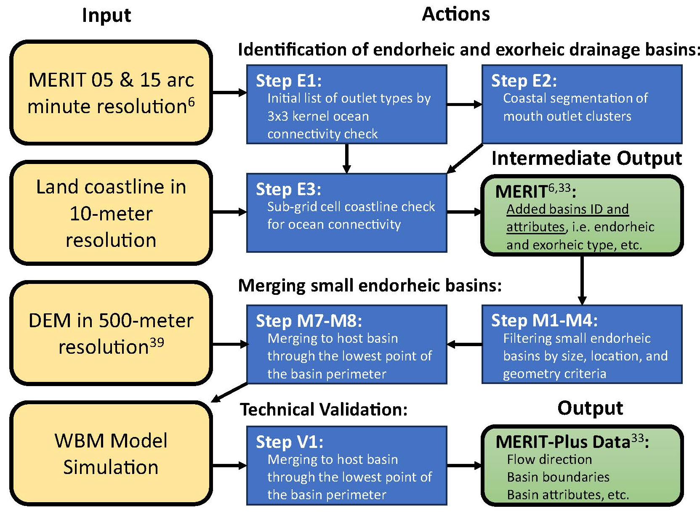
Delineation of endorheic drainage basins in the MERIT-Plus dataset for 5 and 15 minute upscaled river networks
Objective
River basins are defined by surface water flows, which might drain to inland seas and depressions (endorheic) or the ocean (exorheic). Hydrological modeling is hampered by the lack of distinction between these basin types in river databases such as MERIT-Hydro networks re-gridded by the IHU algorithm, which is crucial for understanding of water balances, storage, sea level rise, and other uses.
Approach
We developed a river mouth delineation method to distinguish between endorheic and exorheic basins without changing their flow direction grid, followed by merging of small endoreic basins with larger ones, and data validation with the Water Balance Model.
Impact
The new MERIT-Plus datasets add value to the original IHU MERIT data by identifying endorheic basins with two specialized layers: a gridded layer for endorheic basin IDs and flow direction data. These validated 5 and 15 arc minute upscaled river networks with additional basin attributes, which exhibit a notable decrease in the quantity of endorheic basins yet maintain the overall land area and structure of the inland basins, are available in the data repository.
Flowchart of the workflow to produce the MERIT-Plus datasets. Left column objects are the processing inputs (tan); middle and right column objects are the processing actions (dark blue) and outputs (green).
Prusevich A., Lammers R., Glidden S. Delineation of endorheic drainage basins in the MERIT-Plus dataset for 5 and 15 minute upscaled river networks. Scientific Data 11:61. https://doi.org/10.1038/s41597-023-02875-9

