Slide 1
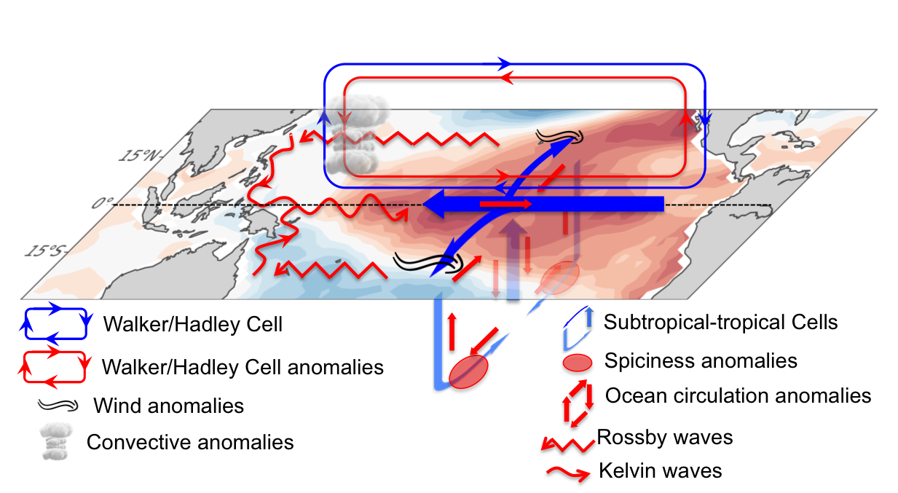
Decadal climate variability in the tropical Pacific
Power, S., G.A. Meehl, and co-authors, 2021: A review of decadal climate variability in the tropical Pacific: Characteristics, causes, predictability and prospects, Science, 374, DOI: 10.1126/science.aay9165.
OBJECTIVE
Tropical Pacific Decadal climate Variability (TPDV) affects billions of people and ecosystems worldwide. While major international efforts are underway to provide decadal climate predictions, there is still a great deal of uncertainty about the characteristics and causes of TPDV, and the accuracy to which it can be simulated and predicted.
APPROACH
We critically synthesize what is currently known and what is not known about TPDV, and provide recommendations to improve our understanding of TPDV and ability to predict it.
IMPACT
While several mechanisms have been proposed to explain TPDV, their relative importance as sources of decadal prediction remains unclear. Issues in need of greater understanding include the role played by the upper ocean overturning circulation in controlling tropical Pacific sea surface temperatures at decadal timescales, as well as the impact of external forcing on the Walker circulation and characteristics of internally-generated TPDV. Model improvements will benefit from in-depth understanding of processes and mechanisms in the tropical Pacific that produce TPDV, their sources of error, and advances in computing technology.
Mechanisms of internal and external TPDV. Schematic of the processes associated with internal TPDV. The upper ocean overturning circulation (the Subtropical-Tropical Cells, transparent blue arrows) consists of a subtropical subduction component, equatorward subsurface transport, equatorial upwelling, and a poleward surface return flow driven by the equatorial easterly trade winds (large blue arrow), which are the surface component of the Walker Cell (WC). A positive phase of internal TPDV with warm SST in the tropical Pacific (red shading) is associated with a weaker WC, reduced equatorial winds, and weaker oceanic overturning. Extra-equatorial wind anomalies may play an important role in driving the changes in the Subtropical-Tropical Cells, whose adjustment is accomplished through the slow westward propagation of oceanic Rossby waves. After reaching the western boundary, Rossby waves can continue along the boundary to the equator as coastal Kelvin waves and along the equator as equatorial Kelvin waves to contribute to transitions of sign of TPDV.

