Slide 1
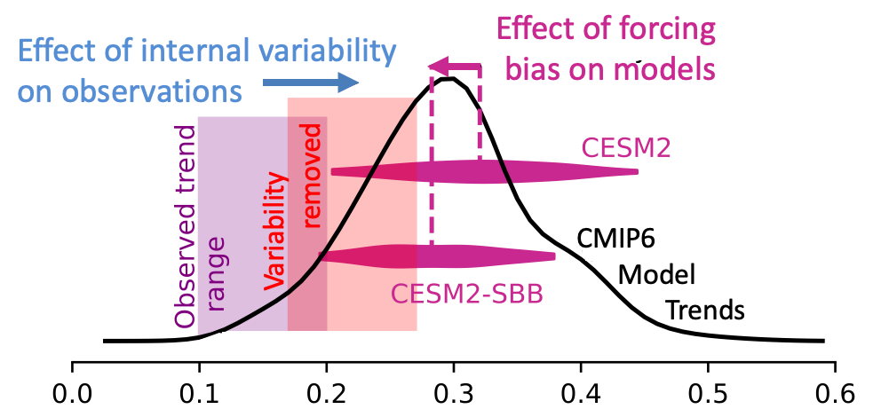
Applying machine learning to isolate and disentangle forced and natural changes in climate
Climate models exhibit twice as much warming as satellite observations. Can natural climate variability explain the gap?
Key Results
Machine learning accurately isolates the contribution of natural variability to warming
Natural variability has substantially reduced satellite-era warming
Biomass burning aerosol emissions biases artificially enhance model-simulated warming
Tropical Tropospheric Warming [K decade⁻¹]
Key Results
Both real-world internal variability and climate model forcing biases help to explain model-satellite differences in warming
Machine learning can inform our interpretation of historical observations
Reference: Po-Chedley, S., J.T. Fasullo, N. Siler, Z.M. Labe, E.A. Barnes, C.J.W. Bonfils, B.D. Santer (2022): "Internal variability and forcing influence model-satellite differences in the rate of tropical tropospheric warming," Proceedings of the National Academy of Sciences, 119 (48) e2209431119, doi: 10.1073/pnas.2209431119.
Notes:
Figure Explanation: CMIP6 model distribution of tropical tropospheric warming trends (black line) and the range of satellite observations (purple shading). When the effects of internal variability are removed, the observed trends shift to the right (closer to the model trends, red shading). The horizontal, purple ”violin plots” show the distribution of 50 CESM2 model trends and the distribution of 50 CESM2 trends with corrected biomass burning aerosol emissions (CESM2-SBB). Removing the forcing biases reduces model warming, bringing the model simulated warming closer to the observations.

