Slide 1
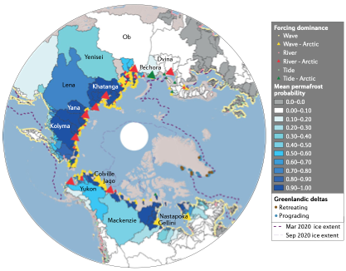
Ice-dominated Arctic deltas
Objective
Highlight the unique controlling factors, seasonality, and morphodynamic processes affecting Arctic deltas
Research
Provide an overview of the history of research on Arctic deltas and describe the many ways in which ice affects their morphology, evolution, and behavior
Utilize a global delta dataset to classify Arctic deltas and explore seasonality of drivers and dynamics
Impact
Showed seasonality of river, wave, and tide processes for deltas across the Arctic
Discussed the role that ice sheets, sea ice, and permafrost play in controlling Arctic deltas and in moderating river, wave, and tidal forcings
Compared characteristics of Arctic deltas to those of global deltas to highlight differences
Hypothesize how Arctic deltas will change in the future with loss of ice and permafrost, impact on coastal ecosystems and nutrient and carbon storage and transport
Circumarctic map of approximately 387 Arctic deltas and their contributing river drainage basins, as delineated from HydroSheds and ETOPO1 data. On the basis of the dominant forcing factors, deltas are classified as fluvial-dominated, wave-dominated or tide-dominated systems. River basins are shaded in blue by mean permafrost probability, which affects their incoming river sediment fluxes. All Arctic deltas are bounded by sea ice for part of the season, as shown by the seasonal maximum sea-ice extent for 2020 (dashed dark purple line), and experience open-water conditions in summer, as shown by the minimum sea-ice extent for 2020 (dashed light purple line). Greenlandic deltas are marked as retreating or prograding over the period 1980–2010. Deltas that are discussed in the Review are labelled.
Overeem, I., J. Nienhuis, and A. Piliouras. (2022). Ice-dominated Arctic deltas. Nature Reviews: Earth and Environment. doi: 10.1038/s43017-022-00268-x

