Slide 1
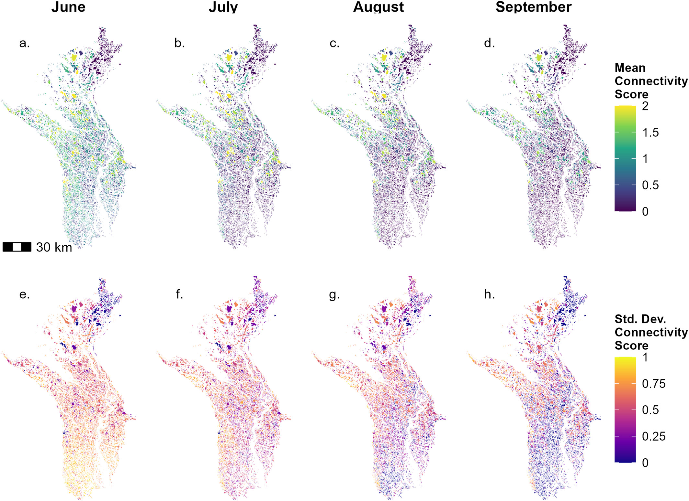
Remote Sensing of Multitemporal Functional Lake-To-Channel Connectivity and Implications for Water Movement Through the Mackenzie River Delta, Canada
Objective
Understand lake-channel connectivity on Arctic deltas and its potential impact on land-ocean sediment flux
Research
Developed new algorithm to quantify connectivity based on turbidity from satellite imagery
Estimate connectivity across major Arctic delta and identify thresholds for time-varying connections
Impact
New algorithm allows for satellite-based estimates of surface water connections and impact on suspended sediment transport to the coast
Connectivity thresholds can be use to model suspended sediment transport through Arctic deltas and storage in abundant delta lakes
Quantifying spatiotemporal lake connectivity helps us better understand flood attenuation in the delta and identify hot spots and hot moments for productivity and nutrient cycling
Top row: Mean monthly functional connectivity classifications. High connectivity scores represent high connectivity, meaning lakes that demonstrate a strong connection to the channel by having similar amounts of suspended sediment within them.
Bottom row: Variability in connectivity over the study period of 1984-2022. Low variability in connectivity implies that lakes are either always well-connected to the channels or always disconnected from the channels. Lakes with high connectivity variability experience temporal changes in their connectivity in a given month, often due to temporal changes in river stage.
Dolan, W., Pavelsky, T. M., & Piliouras, A. (2024). Remote sensing of multitemporal functional lake-to-channel connectivity and implications for water movement through the Mackenzie River Delta, Canada. Water Resources Research. doi: 10.1029/2023WR036614

