Slide 1
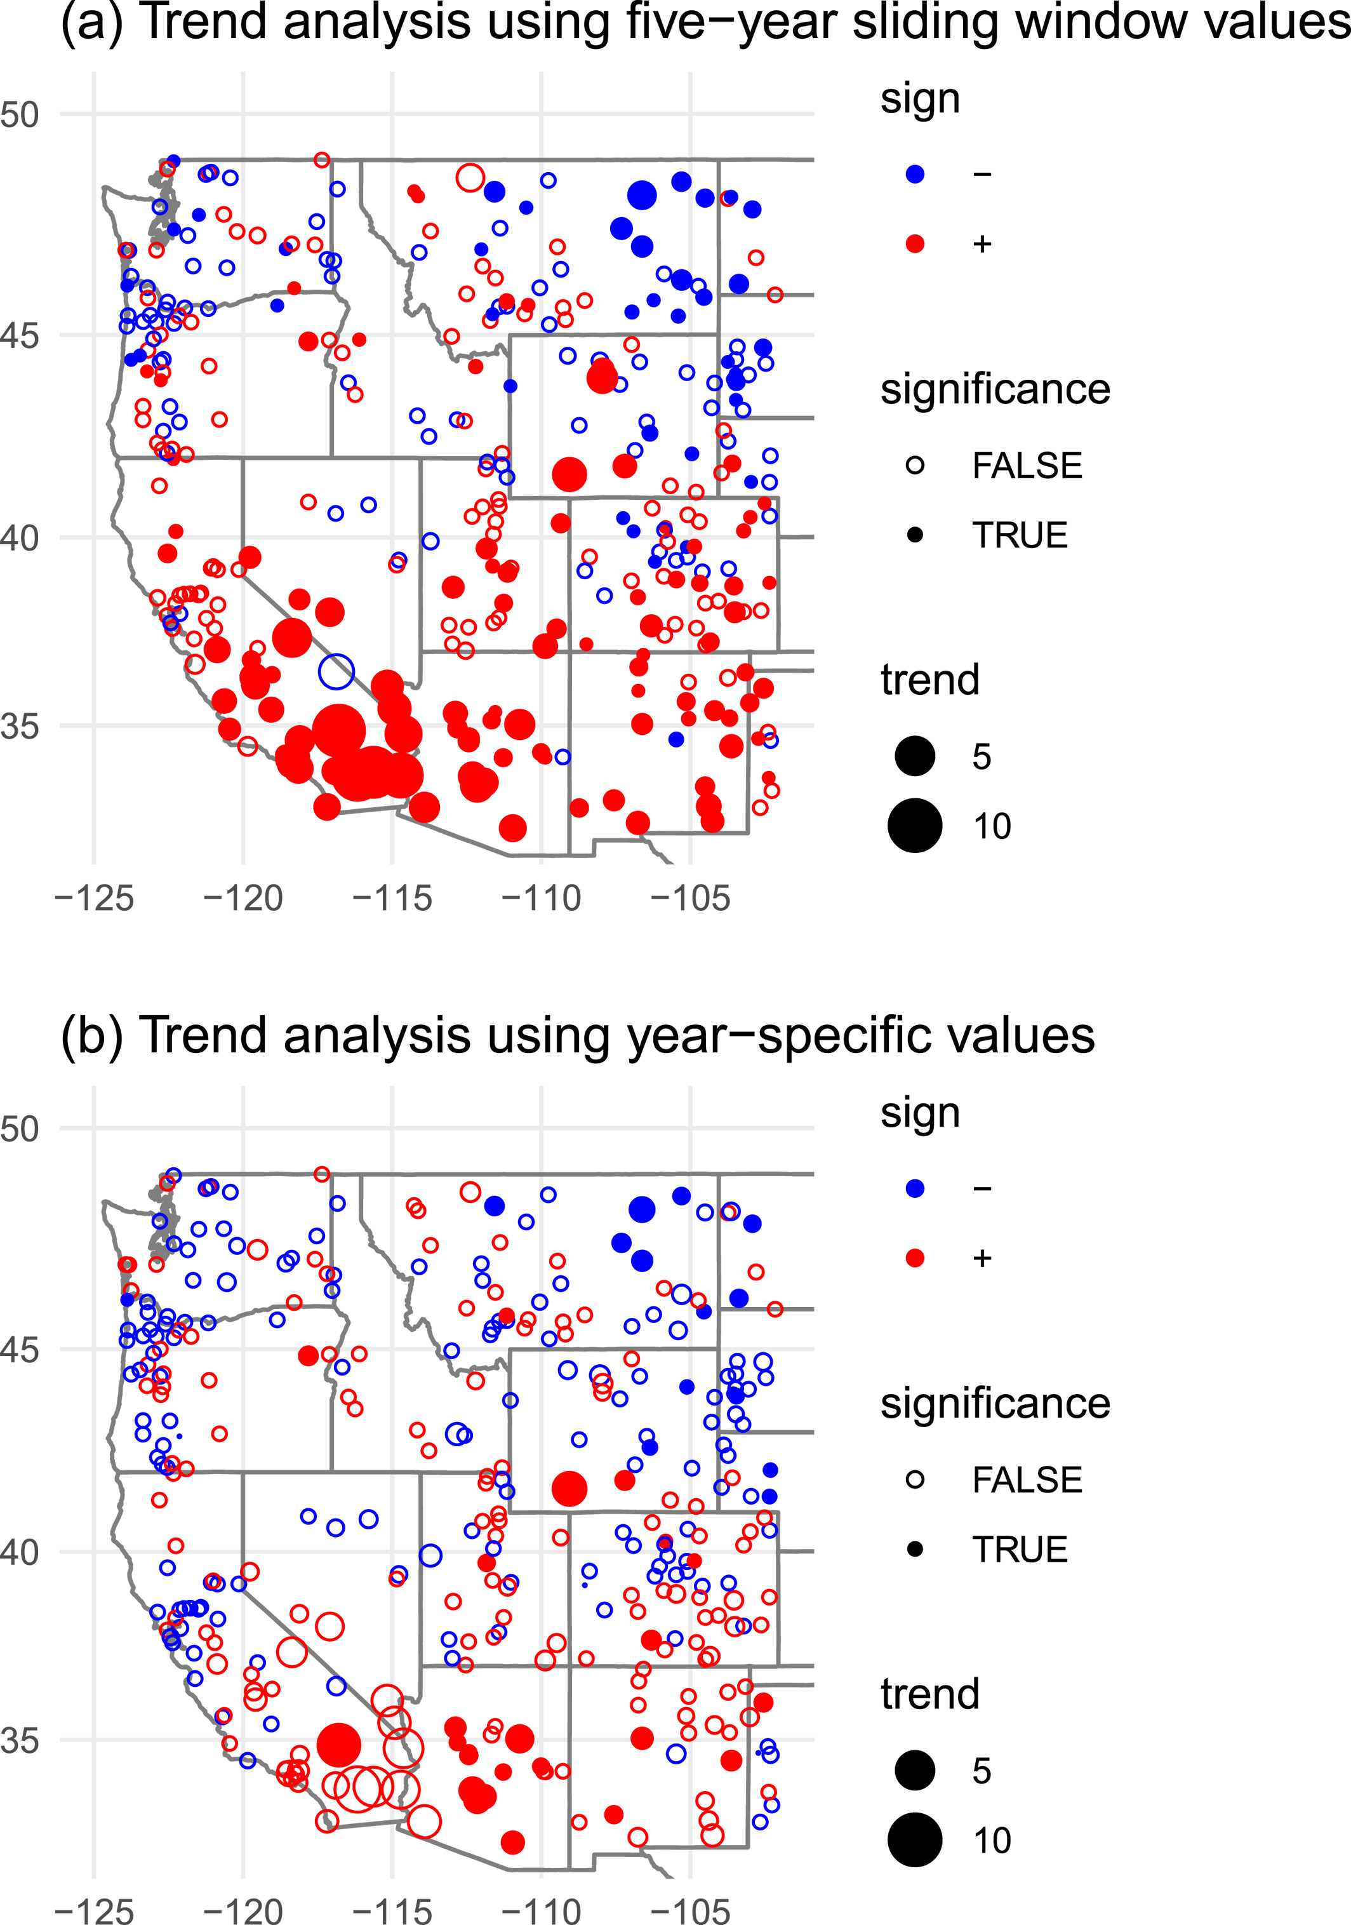
Comment on “Five Decades of Observed Daily Precipitation Reveal Longer and More Variable Drought Events Across Much of the Western United States”
A recent paper reports trends in drought in the western United States, in particular increases in drought in the southwestern United States, based on changes in the lengths of time intervals without precipitation. In this “comment” we note that the preprocessing approach used in the paper artificially increases the apparent statistical signal in the data and caution that the evidence for the trends reported is not as strong as presented in the paper.
We discuss the difficulty of estimating trends in a statistically rigorous fashion across multiple weather stations. Ideally one would adjust the p-values in light of the multiple testing from doing analyses at multiple stations or carry out a joint statistical analysis of all the stations simultaneously in a way that accounts for the spatial correlation structure. While there is statistical literature on spatial multiple testing, there is not a well-developed general methodology for doing so with spatially correlated p-values.
Trend analysis of annual mean dry interval length using Sen's slope (days per decade) and Mann-Kendall test significance (p < 0.05), reproducing Zhang et al. (2021, Figure 3a) using (a) 5-year sliding window values (b) original year-specific values.
Given the limitations of p-values for making affirmative claims about hypotheses, the reduced statistical significance is not grounds for rejecting the hypothesis that Southwest drought is already increasing. At the same time, without a clear statistical procedure that takes account of the spatial context, it's not clear how robust the observed trends in the Southwest are.
Paciorek, C. J., & Wehner, M. F. (2024). Comment on “Five decades of observed daily precipitation reveal longer and more variable drought events across much of the western United States”. Geophysical Research Letters, 51, e2023GL104550. https://doi.org/10.1029/2023GL104550

