Slide 1
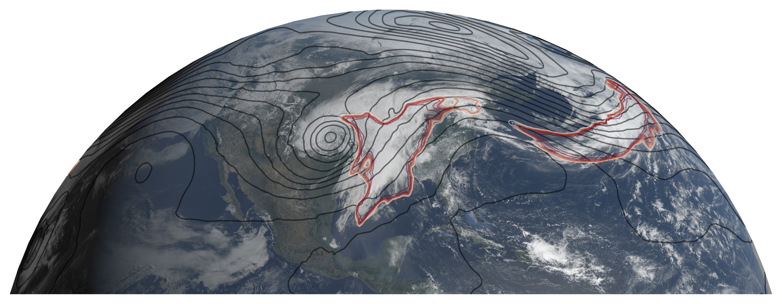
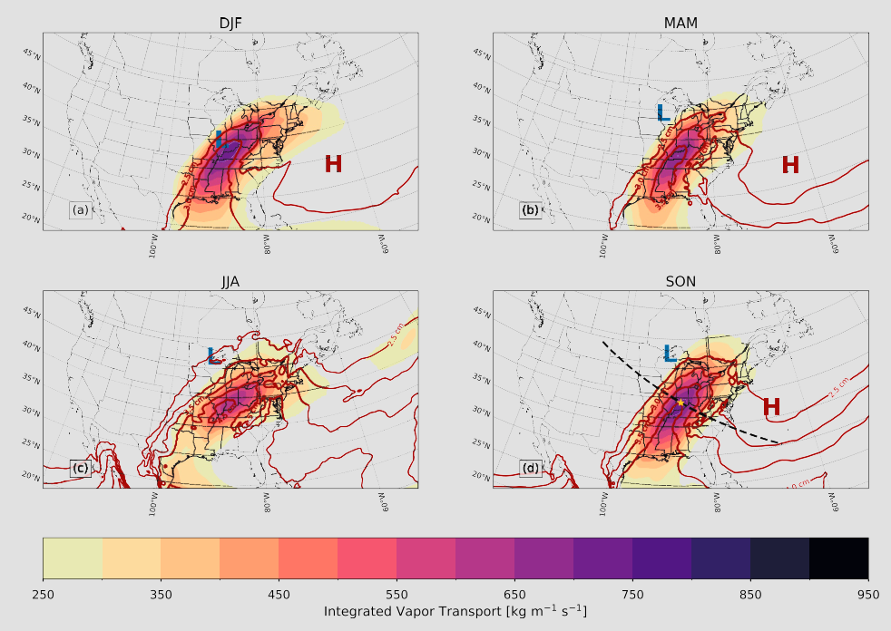


Definitive evidence that atmospheric rivers east of the Rockies are the same as their West Coast counterparts
A new study by researchers at Indiana University and Lawrence Berkeley Lab provides, for the first time, definitive evidence that atmospheric rivers (ARs) in the eastern half of the U.S. systematically occur in conjunction with large-scale weather patterns known as midlatitude cyclones (the apostrophe-shaped cloud feature in the image to the upper left).
Caption: Outline of an atmospheric river impacting the eastern half of the United States (red) overlaid on geostationary satellite imagery from GOES-16
Atmospheric rivers and their impacts are well-studied on the west coast of the U.S., and there is increasing evidence that they are important for the eastern half of the country too. It was not clear, however, whether western and eastern U.S. ARs have the same meteorological drivers. This study demonstrated that knowledge about western U.S. ARs can translate across the U.S.
Analyzed meteorological composites during times with AR conditions, showing clear evidence midlatitude cyclones
Examined multiple locations: Lamont, OK; Bloomington, IN; Washington, D.C.
Showed results are robust with respect to AR detection uncertainty by using multiple detection algorithms from the Atmospheric River Tracking Method Intercomparison Project (ARTMIP)
With interagency coordination, including DOE, NOAA, and NASA, ARTMIP has resulted in 24 publications since 2016.
Caption: Average water vapor and vapor transport during AR conditions over Indiana in all four seasons
O’Brien, T. A. et al. Atmospheric Rivers in the Eastern and Midwestern United States Associated With Baroclinic Waves. Geophysical Research Letters 51, (2024). doi:10.1029/2023GL107236

