Slide 1
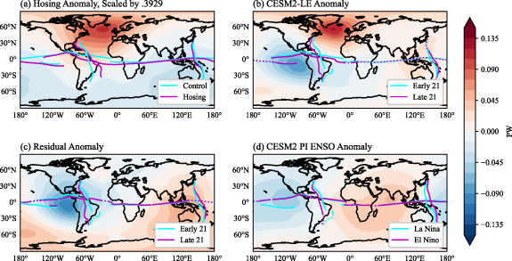
Regional Tropical Rainfall Shifts under Global Warming: an Energetic Perspective
Objective: Future climate simulations feature pronounced spatial shifts in the structure of tropical rainfall. We apply a novel atmospheric energy flux analysis to diagnose late 21st century tropical rainfall shifts in a large ensemble of simulations of 21st century climate. The method reconstructs 2D spatial changes in rainfall based on horizontal shifts in the lines of zero meridional and zonal divergent energy flux, called the energy flux equator (EFE) and energy flux prime meridian (EFPM), respectively.
Approach: Analyzing the CESM2 large ensemble simulations and the CESM hosing simulation.
Results/Impacts: Two main sources of future atmospheric energy flux changes, and hence rainfall shifts, are identified by the analysis: the high-latitude North Atlantic due to a weakened Atlantic Meridional Overturning Circulation that shifts tropical rainfall southwards over the greater Tropical Atlantic sector and eastern Pacific; and the eastern tropical Pacific due to a permanent El-Niño-like response that produces zonal shifts over the Maritime Continent and South America. To first order, the shifts in the EFE and EFPM mirror gross distributional changes in tropical precipitation, with a southward shift in rainfall over the tropical Atlantic, West Africa, and eastern tropical Pacific and an eastward shift over the Maritime Continent and western Pacific. When used to reconstruct future rainfall shifts in the tropical Atlantic and Sahel, the method reasonably represents the simulated meridional structure of rainfall shifts but does not do so for the zonal structures.
Figure 1. AMOC and ENSO-like decomposition of the energy flux potential. (a) Energy flux potential anomaly between the hosing run and the control run (see section 2.3), scaled by 0.3929. (b) Late21 minus Early21 energy flux potential in the CESM2-LE ensemble mean. Panel (c) shows the residual energy flux potential pattern after subtracting out the scaled hosing anomaly (a) from the Late21 and Early21 anomaly (b). Panel (d) shows the energy flux potential anomaly using an ENSO index in the CESM2 pre-industrial control run. While not identical, (c) and (d) both feature a more zonally asymmetric spatial pattern. This motivates labeling the residual as an 'ENSO-like' pattern. In (b) and (c), the cyan curves indicate the Early21 EFE and EFPMs, and the magenta curves indicate the Late21 EFE and EFPMs. In (a) the cyan and magenta curves correspond to the control run and hosing run, respectively, and in (d) they correspond to La Nina years and El Niño years in the pre-industrial control. In panels (b), (c), and (d), solid lines indicate where the shifts in the EFE and EFPM are statistically significant. Note that since there was only one hosing run, no statistical test was performed on the EFE and EFPM in panel (a).
Nicknish, P. A., J. C. H. Chiang, A. Hu, W. R. Boos, 2023, Regional Tropical Rainfall Shifts under Global Warming: an Energetic Perspective, Enviromental Research: Climate, 2, 015007.

