Slide 1
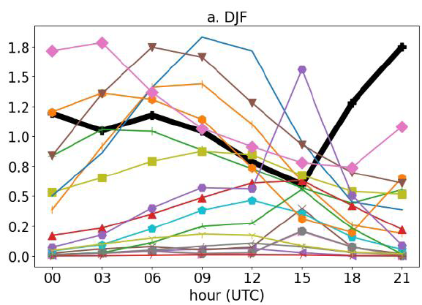
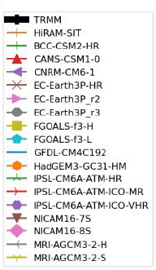
CMIP6 HighResMIP Bias in Extreme Rainfall Drives Underestimation of Amazon Rainfall
Scientific Achievement
Improving model resolution is necessary but not sufficient to enhance the accuracy of rainfall modeling in the Amazon. Additionally, there is an urgent need for measurements to better understand extreme rainfall events.
Significance and Impact
Bias in representing extreme rainfall events produced underestimation of rainfall in the Amazon
Seasonal 3-hour mean of number of extreme events from TRMM 3h (thick black line) and HighResMIP models used.
Research Details
TRMM 3B42 (Tropical Rainfall Measuring Mission) 3-hour data were used as observations.
HighResSST-Present simulation, 3h High Resolution Model Inercomparison Project from Coupled Model Intercomparison Project (HighResMIP, CMIP6) were used.
This study was supported by the Office of Science, Office of Biological and Environmental Research of the US Department of Energy, Agreement Grant DE-AC02-05CH11231 (NGEE-Tropics, RUBISCO).
Negron-Juarez R, Wehner M, Silva Dias M, Ullrich P, Chambers J, Riley W. Coupled Model Intercomparison Project Phase 6 (CMIP6) High Resolution Model Intercomparison Project (HighResMIP) Bias in Extreme Rainfall Drives Underestimation of Amazonian Precipitation. DOI: https://doi.org/10.1088/2515-7620/ad6ff9
Notes:
1-2 paragraph description of highlight – NOT the abstract of the paper… more like talking points for a non-expert speaker using the slide that summarize the most important aspects .
Acknowledgements – from the paper, with additional info if the acknowledgement is not sufficient to list the organizations that supported the research.
Publication/ press releases/ related links:

