Slide 1
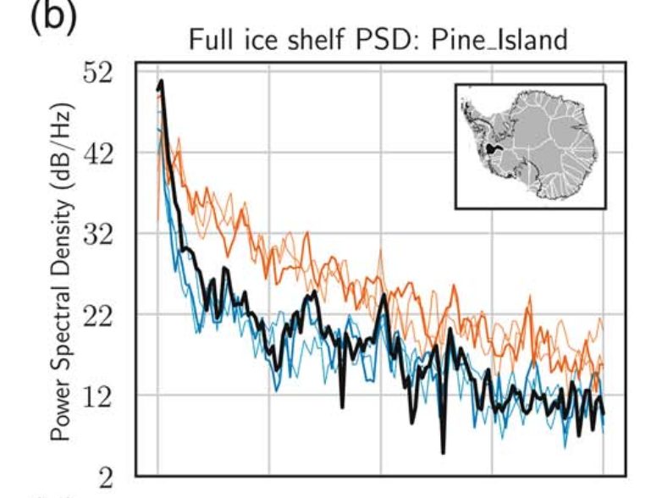
Emulation of Sub-Ice Shelf Melt Forcing Using High-Fidelity E3SM Simulations
Objective
E3SM can simulate Antarctic sub-ice shelf melting in global, coupled configurations
To fully explore the variability in sub-ice shelf melting would require costly ensembles
We develop and demonstrate an alternative, robust but much less costly approach
Approach
Use a whole-Antarctic melt timeseries from E3SM v1 as high-fidelity model data
Construct an accurate statistical emulator of that time series, using a combination of empirical orthogonal functions and Fourier-phase randomization techniques
Quantitatively compare high-fidelity simulation outputs against statistical realizations
Findings & Impact
New emulator mimics regional and local characteristics of modeled melt time series
Statistically generated time series are trivial in cost relative to new ensemble members
Application: Quantifying Antarctic ice sheet evolution uncertainty from internal variability
Figure 1 (above): Power-Spectral Density (PSD) of E3SM-simulated melt-rate time series of Pine Island ice shelf (black), EOF/PCA-based realizations (orange), and realizations from a new, sparse PCA algorithm (blue).
Figure 2 (right): Samples of time evolution for the melt rate (m/yr) of the Filchner ice shelf as generated by the sparse PCE emulator (blue lines) and compared against the E3SM-simulate melt rates (black).
Citation: S. Muruganandham, A. A. Robel, M. J. Hoffman and S. F. Price, Statistical Generation of Ocean Forcing With Spatiotemporal Variability for Ice Sheet Models, Computing in Science & Engineering, 25(3), pp. 30-41, May-June 2023, doi: 10.1109/MCSE.2023.3300908.
Department of Energy • Office of Science • Biological and Environmental Research

