Slide 1
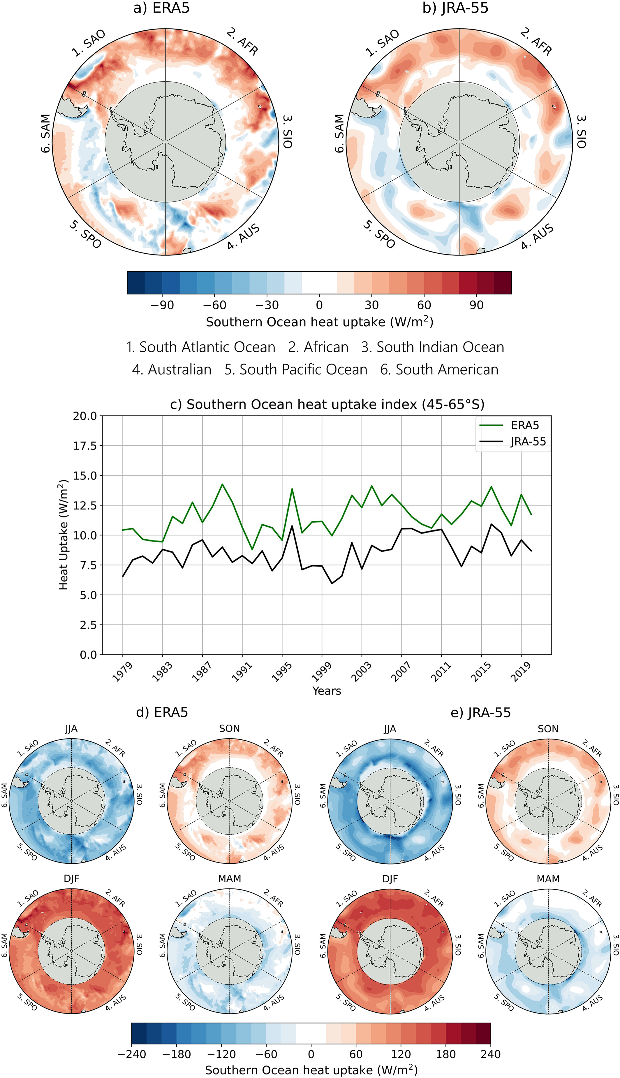
Clouds Amplify Mechanisms of Southern Ocean Heat Uptake
Objective
Understand the roles that atmospheric processes may play in mediating air-sea heat transport in the Southern Ocean (SO).
Identify the influence of clouds on SO heat gain and loss mechanisms from 1979 – 2020.
Approach
Analyze European Centre for Medium-Range Weather Forecasting Re-analysis v5 (ERA5) and the Japanese 55-year Reanalysis (JRA-55) atmospheric reanalysis data sets.
Assess the relationships between ocean heat uptake and different environmental variables to determine the conditions associated with strong ocean heat uptake.
Impact
Anomalously strong annual mean SO heat uptake is mainly controlled by reduced ocean heat loss during winter.
Changes in clouds and their associated atmospheric states amplify ocean heat uptake by increasing downward longwave radiation at the surface.
More clouds occur in a more stable atmosphere, increasing ocean heat uptake by suppressing turbulent heat fluxes from the surface.
(Top) Panels (a) and (b) show common regions of annual mean SO heat uptake in the ERA5 and JRA observationally based analyses (1979 – 2020). Annual mean time series of SO heat uptake (45°–65°S) highlight temporal differences between ERA5 (green) and JRA-55 (black).
Morrison, A.L., Singh, H. A., and Rasch, P. J. “Observations indicate that clouds amplify mechanisms of Southern Ocean heat uptake.” Journal of Geophysical Research: Atmospheres, 127, e2021JD035487 (2022). [DOI: 10.1029/2021JD035487]

