Slide 1
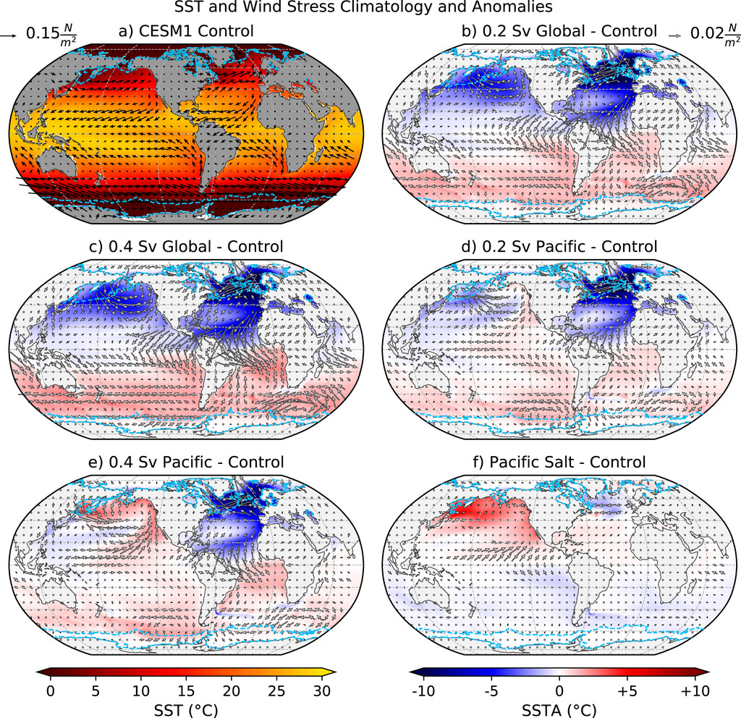
Response of global SSTs and ENSO to AMOC and PMOC
Molina, M. J., A. Hu, and G. A. Meehl, 2022: Response of global SSTs and ENSO to the Atlantic and Pacific meridional overturning circulations. Journal of Climate, 35(1), pp.49-72. https://doi.org/10.1175/JCLI-D-21-0172.1. (DOE-supported authors in bold face)
OBJECTIVE
Consequences from a slowdown or collapse of the Atlantic meridional overturning circulation (AMOC) could include modulations to El Niño–Southern Oscillation (ENSO) and development of the Pacific meridional overturning circulation (PMOC). Five multi-century, fully coupled model simulations created with CESM were used to expand our understanding of the influence of various AMOC and PMOC states on ENSO and global sea surface temperatures (SSTs).
APPROACH
The global-scale ocean circulation named AMOC could be slowing due to climate change. Studies suggest that a slowdown of AMOC could trigger the formation of a Pacific counterpart. Using five multi-century, fully coupled model simulations, we show that different states of these circulations can dramatically alter Earth’s climate and ocean temperatures, contributing to our understanding of potential future and past geological era climates.
IMPACT
We found that the amplitude of annual cycle SSTs across the tropical Pacific decreases and ENSO amplitude increases because of an AMOC shutdown, irrespective of PMOC development. However, active deep overturning circulations in both the Atlantic and Pacific basins reduce ENSO amplitude and variance of monthly SSTs globally. These results suggest that if climate simulations projecting AMOC weakening are realized, compounding climate impacts could occur given the far-reaching ENSO teleconnections to extreme weather and climate events.
SSTs and surface wind stress of the CESM1 control and anomalies computed as the difference between the sensitivity experiments and the CESM1 control. Light blue contours contain locations where sea ice was present at any point during the respective simulations.

