Slide 1
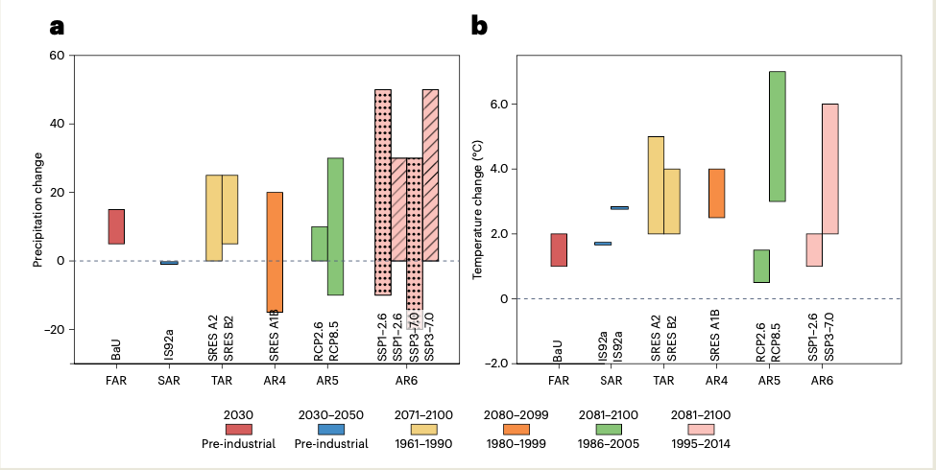
A need for actionable climate projections across the Global South
Mishra, S. K., Upadhyaya, P., Fasullo, J. T., Keshri, N. P., Salunke, P., Ghosh, A., ... & Kang, I. S. (2023). A need for actionable climate projections across the Global South. Nature Climate Change, 13(9), 883-886, doi: 10.1038/s41558-023-01778-2.
OBJECTIVE
The goal of this work is to highlight the lack of agreement in climate projections for the Global South across successive IPCC reports, which is particularly strong for precipitation, and to suggest paths forward using emerging technologies and strengthening international collaborations.
APPROACH
This commentary uses multiple generations of CMIP output to demonstrate a lack of agreement across the reports, particularly in precipitation projections. Opportunities associated with ongoing technological developments, including machine learning and high-resolution modeling, and regional coordinated climate assessments are highlighted.
IMPACT
This work draws attention to the heightened vulnerability of the Global South in the context of both model structural uncertainty and uncertain trajectories of future anthropogenic emissions. These vulnerabilities are compounded by the limited resources of countries in the Global South to conduct their own regional modeling and climate assessments. Various suggestions are made including coordinated assessment and modeling activities across countries.
Projected changes in precipitation and surface air temperature for South Asia. a, Projected precipitation changes from the six IPCC reports for different emission scenarios — First Assessment Report (FAR) for BaU, Second Assessment Report (SAR) for IS92a, TAR for SRES A2 and B2, Fourth Assessment Report (AR4) for A1B, Fifth Assessment Report25 (AR5) for RCP2.6 and RCP8.5, and AR6 for SSP1-2.6 and SSP3-7.0. Projections are shown for annual mean precipitation from all the reports except for FAR (summer), SAR (summer), and AR6 (winter – stippled and summer – hatched). b, Same as (a) but for surface air temperature with differences for FAR, SAR and AR6. Projections are shown for annual mean surface air temperature for all the reports except for SAR for which the projections are shown for the winter (first bar) and summer (second bar).

