Slide 1
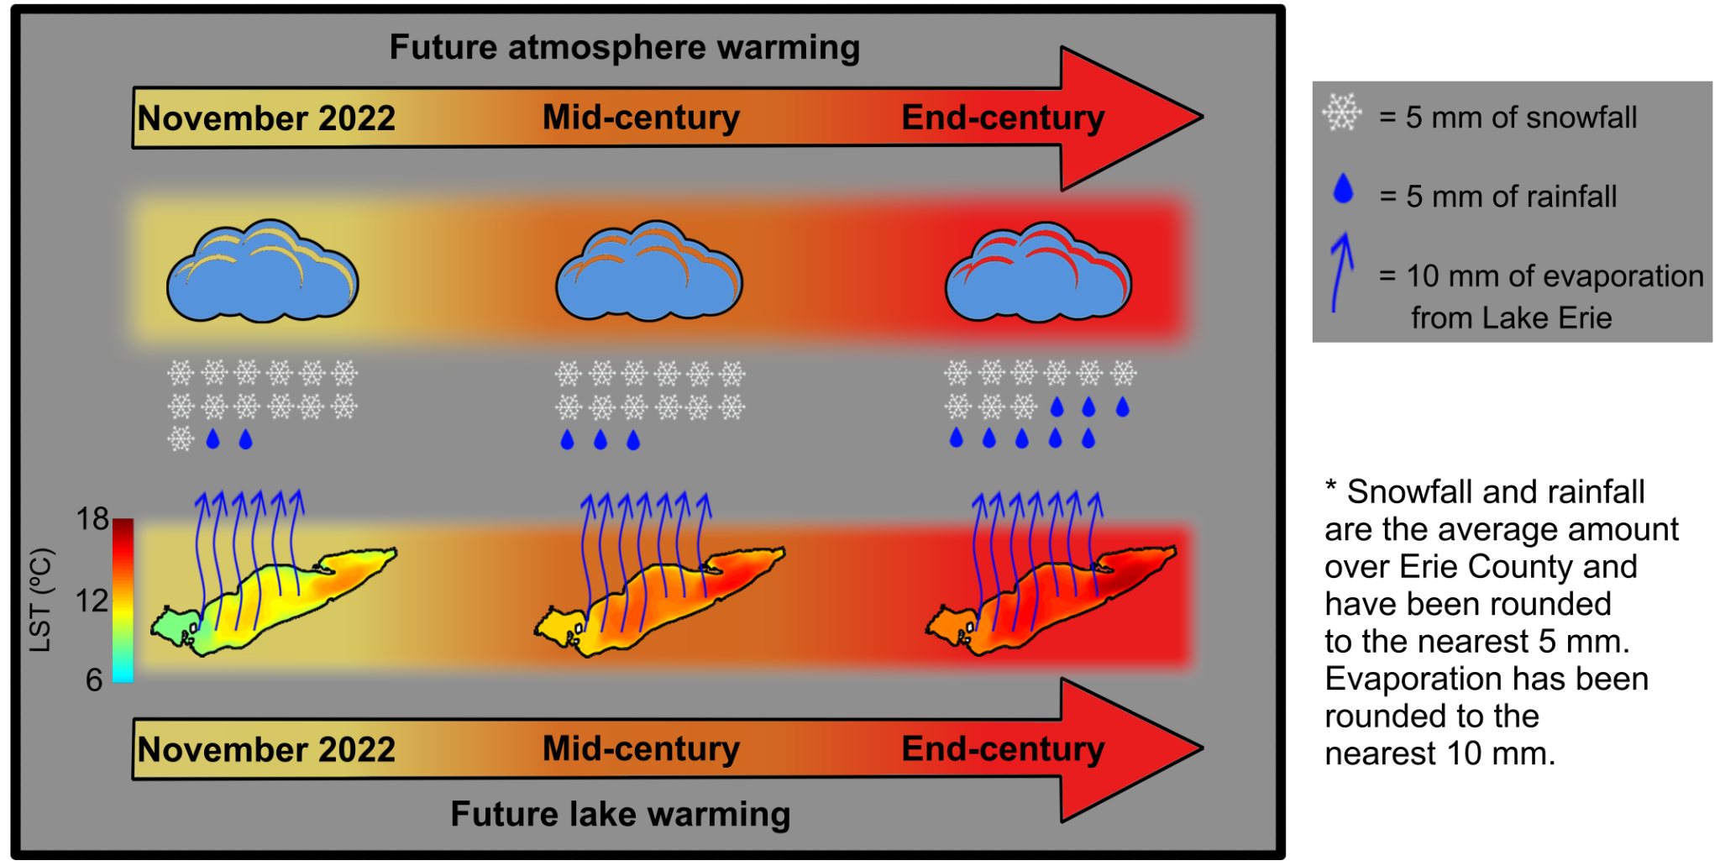
How Could Future Climate Reshape a Devastating Lake-Effect Snow Storm?
Scientific Challenge
Our current understanding of the future evolution of lake-effect snow (LES) storms is limited due to rudimentary representations of the Great Lakes and their lake-atmosphere interaction in climate modeling systems.
We also lack an event-oriented future storyline of an LES storm in order to better characterize this winter extreme and improve risk-awareness.
Approach and Findings
Researchers used a fully three-dimensional lake-land-atmosphere modeling system, along with the Pseudo-Global Warming technique, to investigate how a storm similar to the November 2022 Buffalo LES storm would manifest in a future climate.
Results revealed that in a warmer future, the storm precipitation increases by up to 14%, with an increase in rain as a fraction of the total precipitation.
Significance and Impact
This study provides a plausible future storyline for the Buffalo LES storm, focusing on understanding the intricate lake-atmosphere interaction that will shape the future dynamics of LES storms.
Failure to capture lake-atmosphere interactions result in significant misrepresentation of future LES storms, demonstrated in our study by counterfactual storylines that hold either present day lake or atmosphere conditions constant.
Changes in the November 2022 Buffalo LES storm precipitation when the climate (i.e., both the atmosphere and lake) are warmed to future mid-century and end-century levels.
Kayastha, M. B. et al. “How Could Future Climate Conditions Reshape a Devastating Lake-Effect Snow Storm?” Earth's Future 12, e2024EF004622, doi: https://doi.org/10.1029/2024EF004622 (2024).
Department of Energy • Office of Science • Biological and Environmental Research
Notes:
Word highlight text here.

