Slide 1
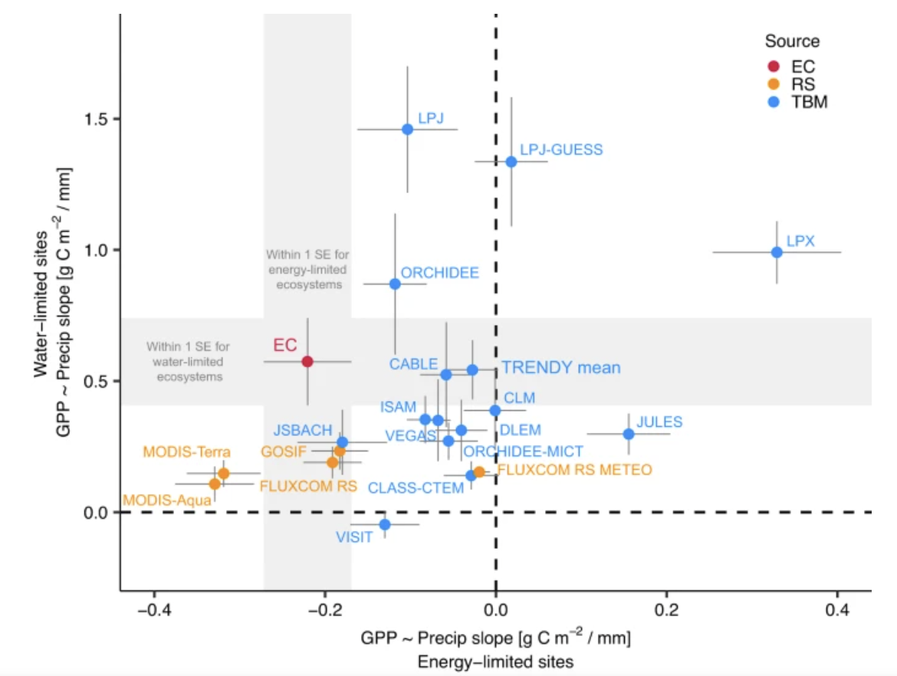

Increased photosynthesis during spring drought in energy-limited ecosystems
Scientific Achievement
We find a consistent increase in eddy covariance GPP during spring drought in energy-limited ecosystems.
Our results suggest GPP increases during spring drought for 55% of vegetated Northern Hemisphere lands ( >30° N).
In contrast to trends detected in eddy covariance data, model mean GPP always declined under spring precipitation deficits after controlling for air temperature and light availability.
Significance and Impact
These results highlight the need for land surface models to better account for the varying effects of meteorological drought on carbon cycling in mid- and high-latitude ecosystems.
Fig. Eddy covariance (EC) observations of spring GPP sensitivities to precipitation occupy a different region of sensitivity space than terrestrial biosphere models (TBM) and satellite remote sensing (RS) products. Points show energy-limited (x) vs water-limited (y) mean spring GPP sensitivities to precipitation, with labels for each model or product. Gray rectangles project EC SEs across the plot. Points falling within the gray rectangles have GPP sensitivities within 1 SE of the EC observation means.
Research Details
In this study, we use carbon flux observations, remote sensing and land surface models to examine the response of photosynthesis (gross primary productivity) to meteorological drought across a spatial gradients along the water-energy limitation spectrum
Miller J et al. (2023), Nature Communications
DOI: https://doi.org/10.1038/s41467-023-43430-9

