Slide 1
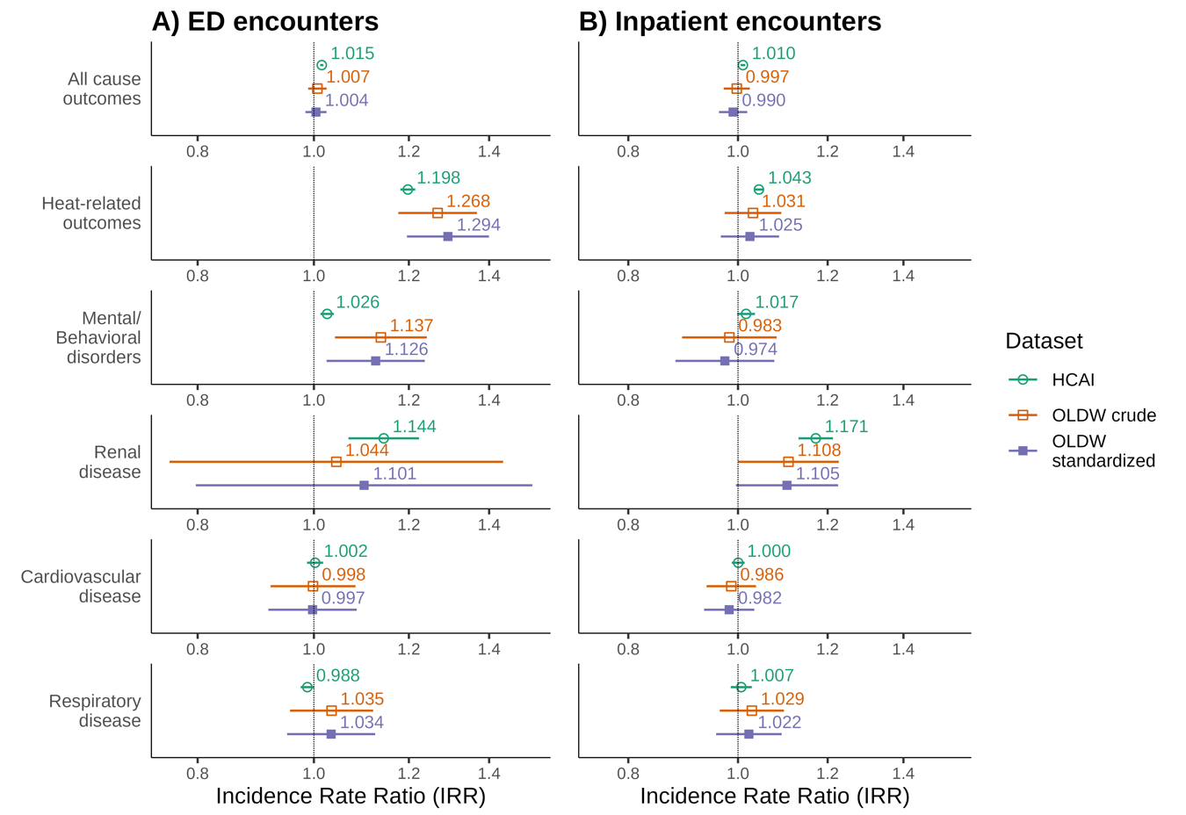
Generalizability of heat-related health risk associations observed in a large healthcare claims database of patients with commercial health insurance
Objective
Extreme heat is associated with higher risk of illness and death. Databases of medical claims from US patients with commercial or Medicare Advantage health insurance, have been used to quantify the health impacts of heat. We investigate if results for the insured sub-population generalize to the broader (insured + uninsured) population.
Approach
Using data on California hospital visits 2012 - 2019 from Optum Labs Data Warehouse and California Department of Health Care Access and Information we examined emergency department (ED) and in-patient encounters for all-causes, heat-related outcomes, renal disease, mental/behavioral disorders, cardiovascular disease, and respiratory disease. We defined extreme heat exposure as any day in a group of 2 or more days with maximum temperatures exceeding the county-specific 97.5th percentile and used a space-time-stratified case–crossover design to assess the impacts of heat on health.
Impact
While average incidence rates of medical encounters differed by dataset, rate ratios for ED encounters were similar across datasets for all causes. Rate ratios for inpatient encounters were also similar. Results suggest that medical claims data can serve as a valid resource for estimating the health impacts of extreme heat.
Incidence rate ratios (IRR) and 95% confidence intervals by outcome for A) emergency department encounters and B) Inpatient encounters on the any day of the heatwave compared to a non-heatwave day in the same county, year, month, and day of week.
Milando, Chad W.; Sun, Yuantong; Romitti, Yasmin; Nori-Sarma, Amruta; Gause, Emma L.; Spangler, Keith R.; Sue Wing, Ian; Wellenius, Gregory A. Generalizability of heat-related health risk associations observed in a large healthcare claims database of patients with commercial health insurance. Epidemiology ():10.1097/EDE.0000000000001781.

