Slide 1
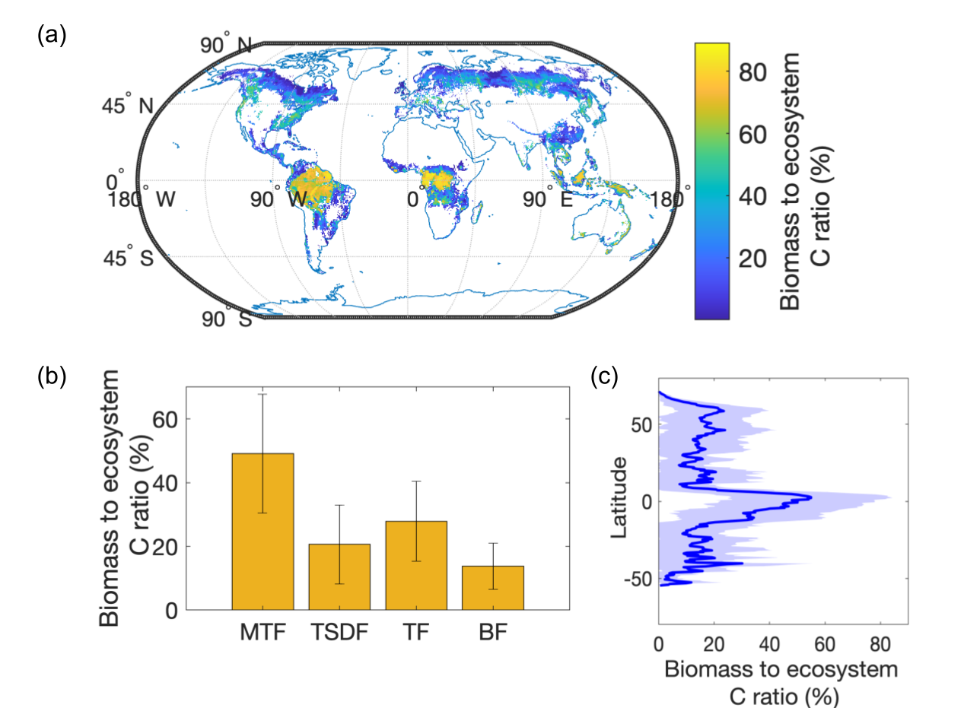

Climate change will increase biomass proportion of global forest carbon stocks under an SSP5–8.5 climate trajectory
Scientific Challenges
A large amount of carbon is stored in global forests. However, the fraction of carbon stored as plant biomass vs. soil organic carbon varies among forest types, and potential changes over the 21st century are uncertain.
Approach and Results
We used extensive data derived from inventories and remote sensing and CMIP6 models. Over the 21st century, we showed that the ratio of biomass to ecosystem carbon in global forests will increase, with the largest increases in boreal forests and lowest increases in moist tropical forests.
Significance
Figure. Observationally-inferred biomass to ecosystem carbon ratio varies across global forest biomes. Data-derived plant biomass to ecosystem carbon ratios across (a) global land areas covered by forests, (b) global forest biomes (moist tropical forests (MTF), tropical and subtropical dry forests (TSDF), temperate forests (TF), and boreal forests (BF)), and (c) across latitudes.
Alterations in the structure of global forests and the distribution of carbon within ecosystems, leading to a higher proportion of carbon stored in plant biomass, will have important implications for surface energy balances, disturbance regimes, ecosystem carbon balance, and thus feedbacks with the climate system.
Mekonnen, Z. A., & Riley, W. J. (2023). Climate change will increase biomass proportion of global forest carbon stocks under an SSP5–8.5 climate trajectory. Geophysical Research Letters, 50, e2023GL104612. https://doi.org/10.1029/2023GL104612

