Slide 1
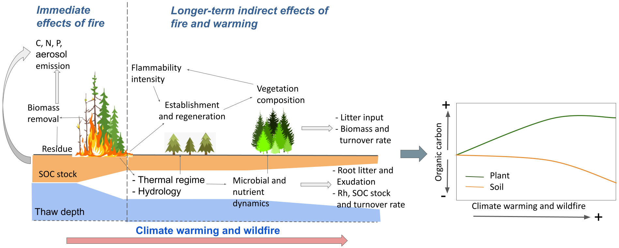
Wildfire exacerbates high-latitude soil carbon losses from climate warming
Scientific Achievement
Using a mechanistic ecosystem model, we show that that high-latitude ecosystem carbon dynamics exhibit different trends of plant and soil carbon under future warming and wildfire: sustained plant carbon gains that led to greater biomass vs. concurrent SOC losses
Significance and Impact
Carbon losses from (1) wildfire combustion and (2) rapid SOC decomposition driven by increased litter production, root exudation, and active layer depth will lead to about 4.4 PgC of soil carbon losses from Alaska by year 2300
Wildfire increases SOC losses by a factor of about 4 across Alaska by the year 2300, compared to current conditions.
Figure. Immediate direct and longer-term indirect effects of wildfire interact with warming to influence high-latitude soil
carbon stocks. Effects of climate warming and wildfire include a complex set of soil–plant–atmosphere interactions that affect ecosystem carbon balance.
Research Details
We applied a mechanistic and widely-tested ecosystem model, ecosys, to examine the direct and indirect effects of wildfire on ecosystem and SOC stocks, across ecosystems of Alaska under historical and future climate and wildfire.
Mekonnen, Z.A., Riley, W.J., Randerson, J.T., Shirley, I.A., Bouskill, N.J. and Grant, R.F., 2022. Wildfire exacerbates high-latitude soil carbon losses from climate warming. Environmental Research Letters, 17(9), p.094037.

