Slide 1
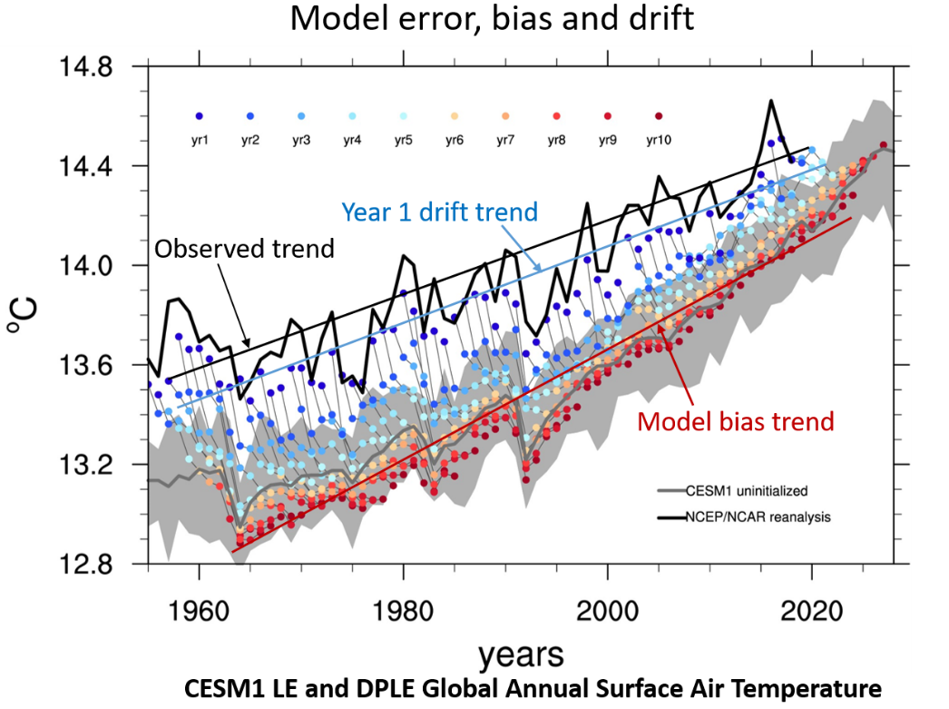
The effects of bias, drift, and trends in seasonal-to-decadal initialized climate predictions
G.A. Meehl, H. Teng, D. Smith, S. Yeager, W. Merryfield, F. Doblas-Reyes, and A.A. Glanville, 2022: The effects of bias, drift, and trends in calculating anomalies for evaluating skill of seasonal-to-decadal initialized climate predictions, Climate Dynamics, https://doi.org/10.1007/s00382-022-06272-7.
(DOE-supported authors in bold face)
OBJECTIVE
In initialized seasonal to decadal (S2D) predictions, model hindcasts rapidly drift away from the initial observed state and converge toward a preferred state characterized by systematic error, or bias. Bias and drift are among the greatest challenges facing initialized climate prediction today. Differences in trends between initial states and drifted states, combined with bias and drift, introduce complexities in calculating anomalies to assess skill of initialized predictions.
APPROACH
We examine several methods of calculating anomalies using the Decadal Prediction Large Ensemble (DPLE) initialized hindcasts and focus on Pacific and Atlantic SSTs to illustrate issues with anomaly calculations. Three methods of computing anomalies, one as differences from a long term model climatology, another as bias-adjusted differences from the previous 15 year average from observations, and a third as differences from the previous 15 year average from the model, are contrasted and each is shown to have limitations.
IMPACT
The IPO transition in the 2014-2016 time frame from negative to positive (predicted by Meehl et al. 2016) did indeed verify using all three methods, though each provides somewhat different skill values as a result of the respective limitations. There is no clear best method, as all are roughly comparable, and each has its own set of limitations and caveats. However, all three methods show generally higher overall skill in the AMO region compared to the IPO region.
Globally averaged surface air temperature predictions from the CESM1 Decadal Prediction Large Ensemble (DPLE) as a function of simulation year. Initial state predictions (blue dots) compare well with observations (black line), but drift (progression of blue dots to red dots) towards the model’s systematic error state represented by the uninitialized state from the CESM1 Large Ensemble (LE), dark grey line; grey shading is range of uninitialized projections

