Slide 1
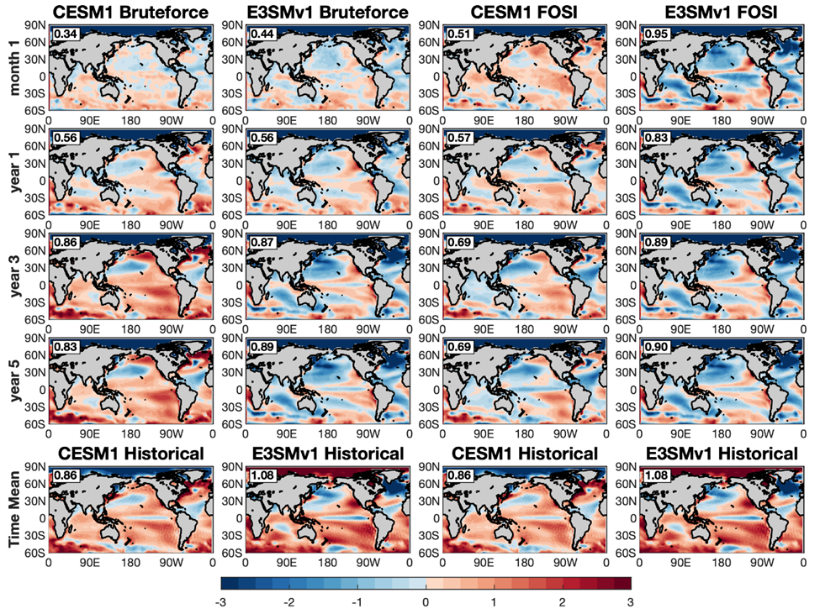
E3SMv1 and CESM1 initialized multi-year Earth system predictions
Meehl, G.A., B. Kirtman, J. Richter, A.A Glanville, N. Rosenbloom, and S. Yeager, 2023: Evaluating skill in predicting the Interdecadal Pacific Oscillation in initialized decadal climate prediction hindcasts in E3SMv1 and CESM1 using two different initialization methods and a small set of start years, Climate Dynamics, https://doi.org/10.1007/s00382-023-06970-w. (DOE RGMA authors in bold face)
OBJECTIVE
A major challenge in initialized multi-year Earth system predictions is to have enough ensemble members and associated start years to form a drifted climatology from which to compute the anomalies necessary to quantify the skill of the hindcasts when compared to observations. We use the standard 1° resolution E3SMv1 and CESM1 to explore new ways to approach this problem.
APPROACH
A set of multi-year Earth system predictions are run with E3SMv1 and CESM1 using two different initialization methods for a limited set of start years. A new method using the respective uninitialized free-running historical simulations to form the model climatologies is tested. The drifts from the observed initial states in the hindcasts toward the uninitialized model states are large and rapid. Therefore, hindcasts from the limited start years can use the uninitialized climatology to represent the drifted model states after about lead year 3.
IMPACT
There is comparable skill for predicting spatial patterns of multi-year Pacific sea surface temperature anomalies using two different initialization methods and the historical large ensembles from the models to represent a drifted model climatology, as opposed to having to run a large and expensive hindcast set of simulations for every new experiment or model formulation. This result opens up new directions in the field of multi-year Earth system prediction to allow case studies and limited start years to study processes previously not thought to be feasible.
Ensemble mean SST bias as represented by drifts (°C) from the observations (first 4 rows), showing by lead year 3 (3rd row) the drift errors from both models and both initialization methods approach the historical large ensemble systematic errors in the 5th row. Root mean square errors are shown in the upper left corner of each panel.

