Slide 1
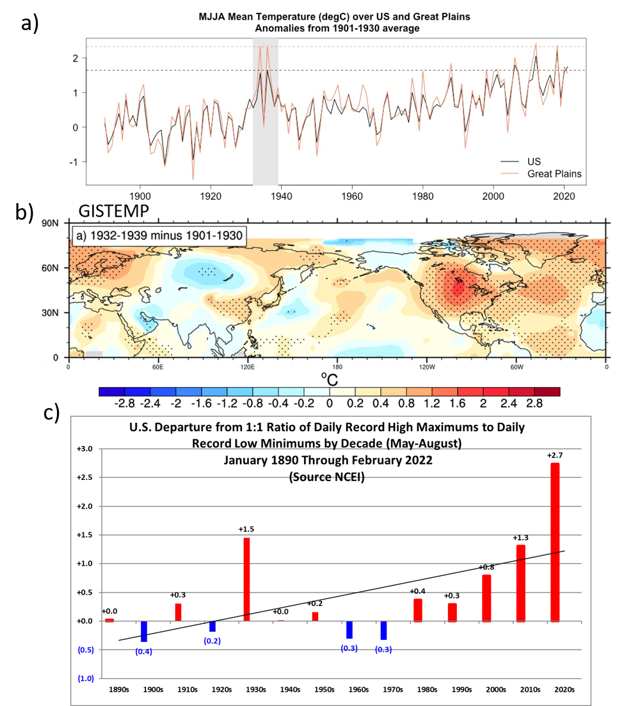
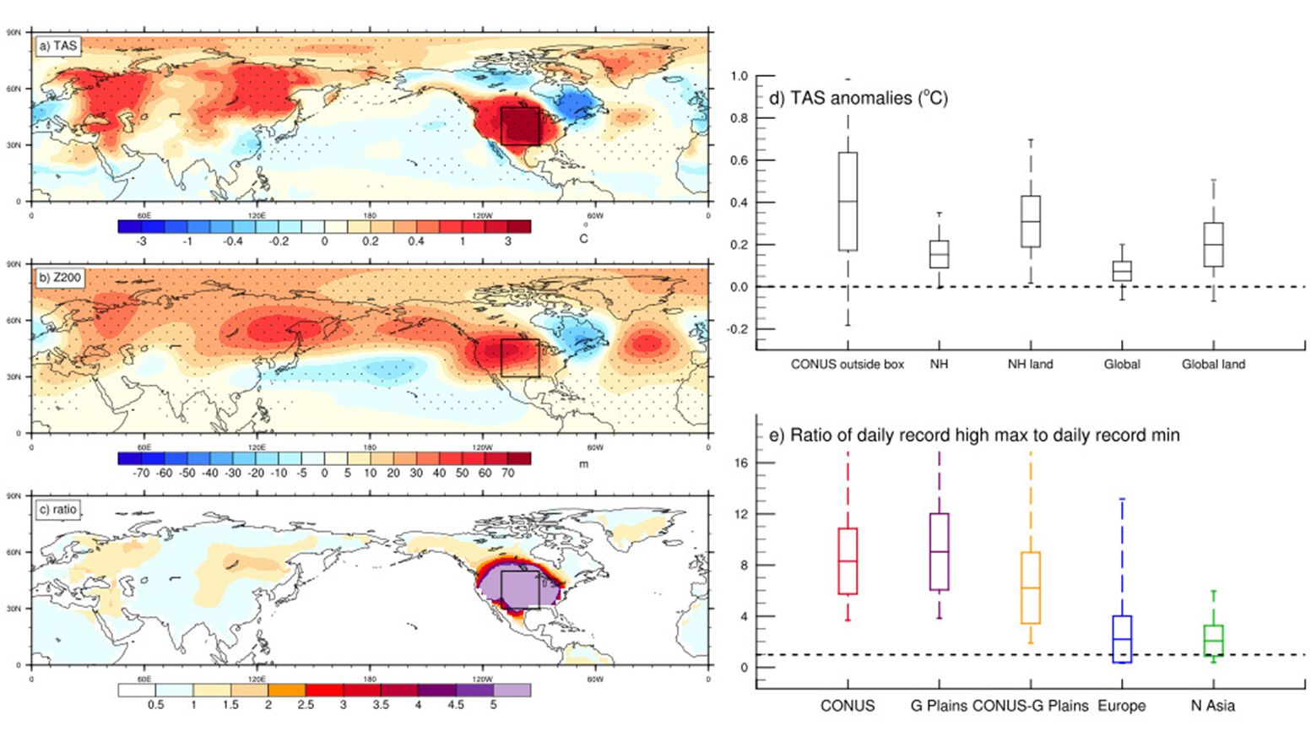
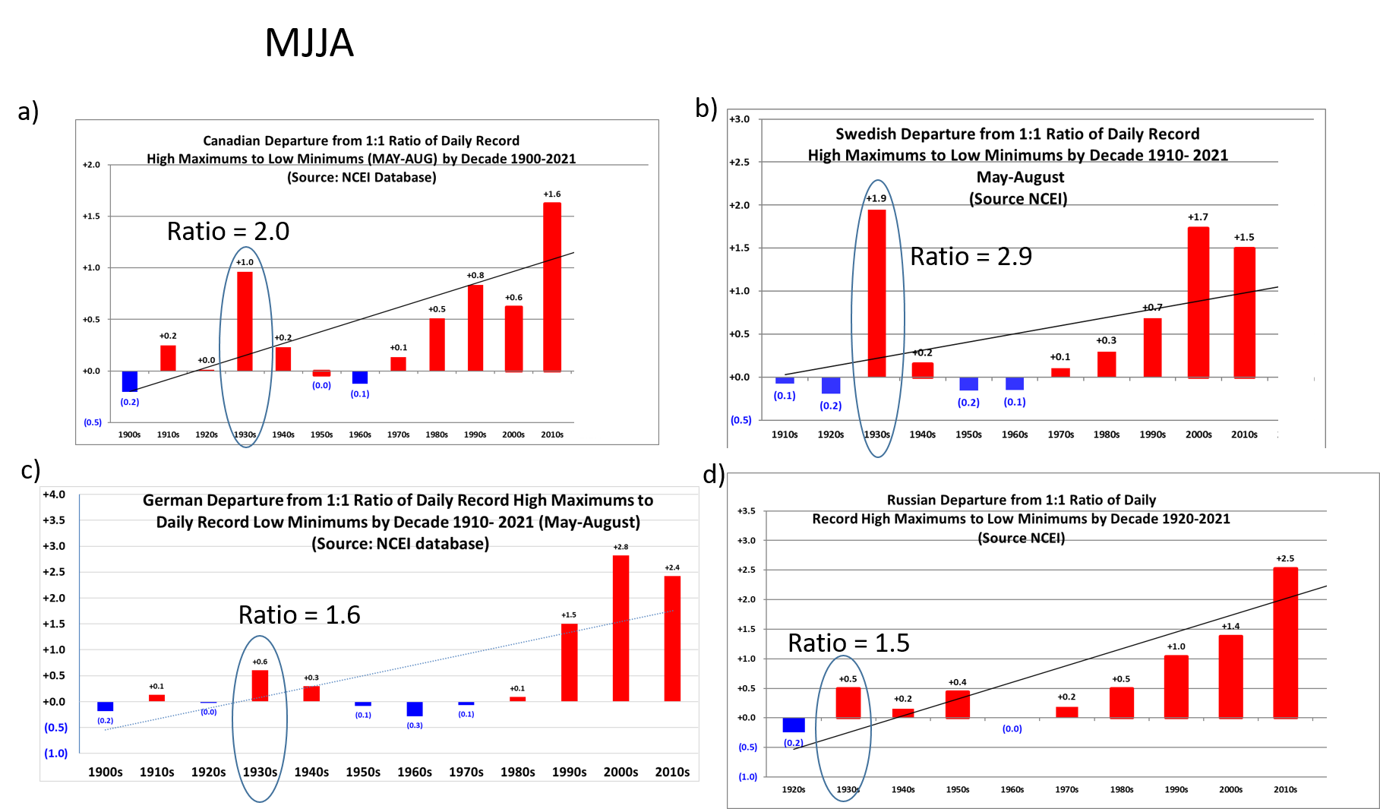
How the Great Plains Dust Bowl Drought spread heat extremes around the Northern Hemisphere
G.A. Meehl, H. Teng, N. Rosenbloom, A. Hu, C. Tebaldi, and G. Walton, 2022: How the Great Plains Dust Bowl Drought spread heat extremes around the Northern Hemisphere, Nature Scientific Reports, doi:10.1038/s41598-022-22262-5. (DOE RGMA authors in bold face)
OBJECTIVE
We seek to identify the connection between record setting heat over the US associated with the Great Plains Dust Bowl drought, and extraordinary heat extremes in areas of the Northern Hemisphere far from North America
APPROACH
A climate model sensitivity experiment run with a version of the atmospheric model in E3SMv1 is used to identify a new mechanism involving a warm season circumglobal wave-5 atmospheric teleconnection pattern that spread heat extremes over far-flung areas of the Northern Hemisphere that was forced by the intense heating over the desiccated Great Plains themselves.
IMPACT
It has only been in the 21st century that human populations in these regions of the Northern Hemisphere have experienced heat extremes comparable to the 1930s. This demonstrates that humans influenced Northern Hemisphere temperature and heat extremes through disastrous and unprecedented regional land use practices over the Great Plains, and points to the possibility that future intense regional droughts could affect heat extremes on hemispheric scales.
The 1930s stand out for observed record-setting heat by decade (in bar charts for the continental U.S., Canada, and Eurasia, represented by the ratio of daily record high maximum temperatures to record daily record low minimum temperatures (greater record heat depicted as ratios greater than the nominal value of 1.0). These connections are due to a circumglobal wave-5 pattern forced by heating over the Great Plains during the 1930s (top right)

