Slide 1
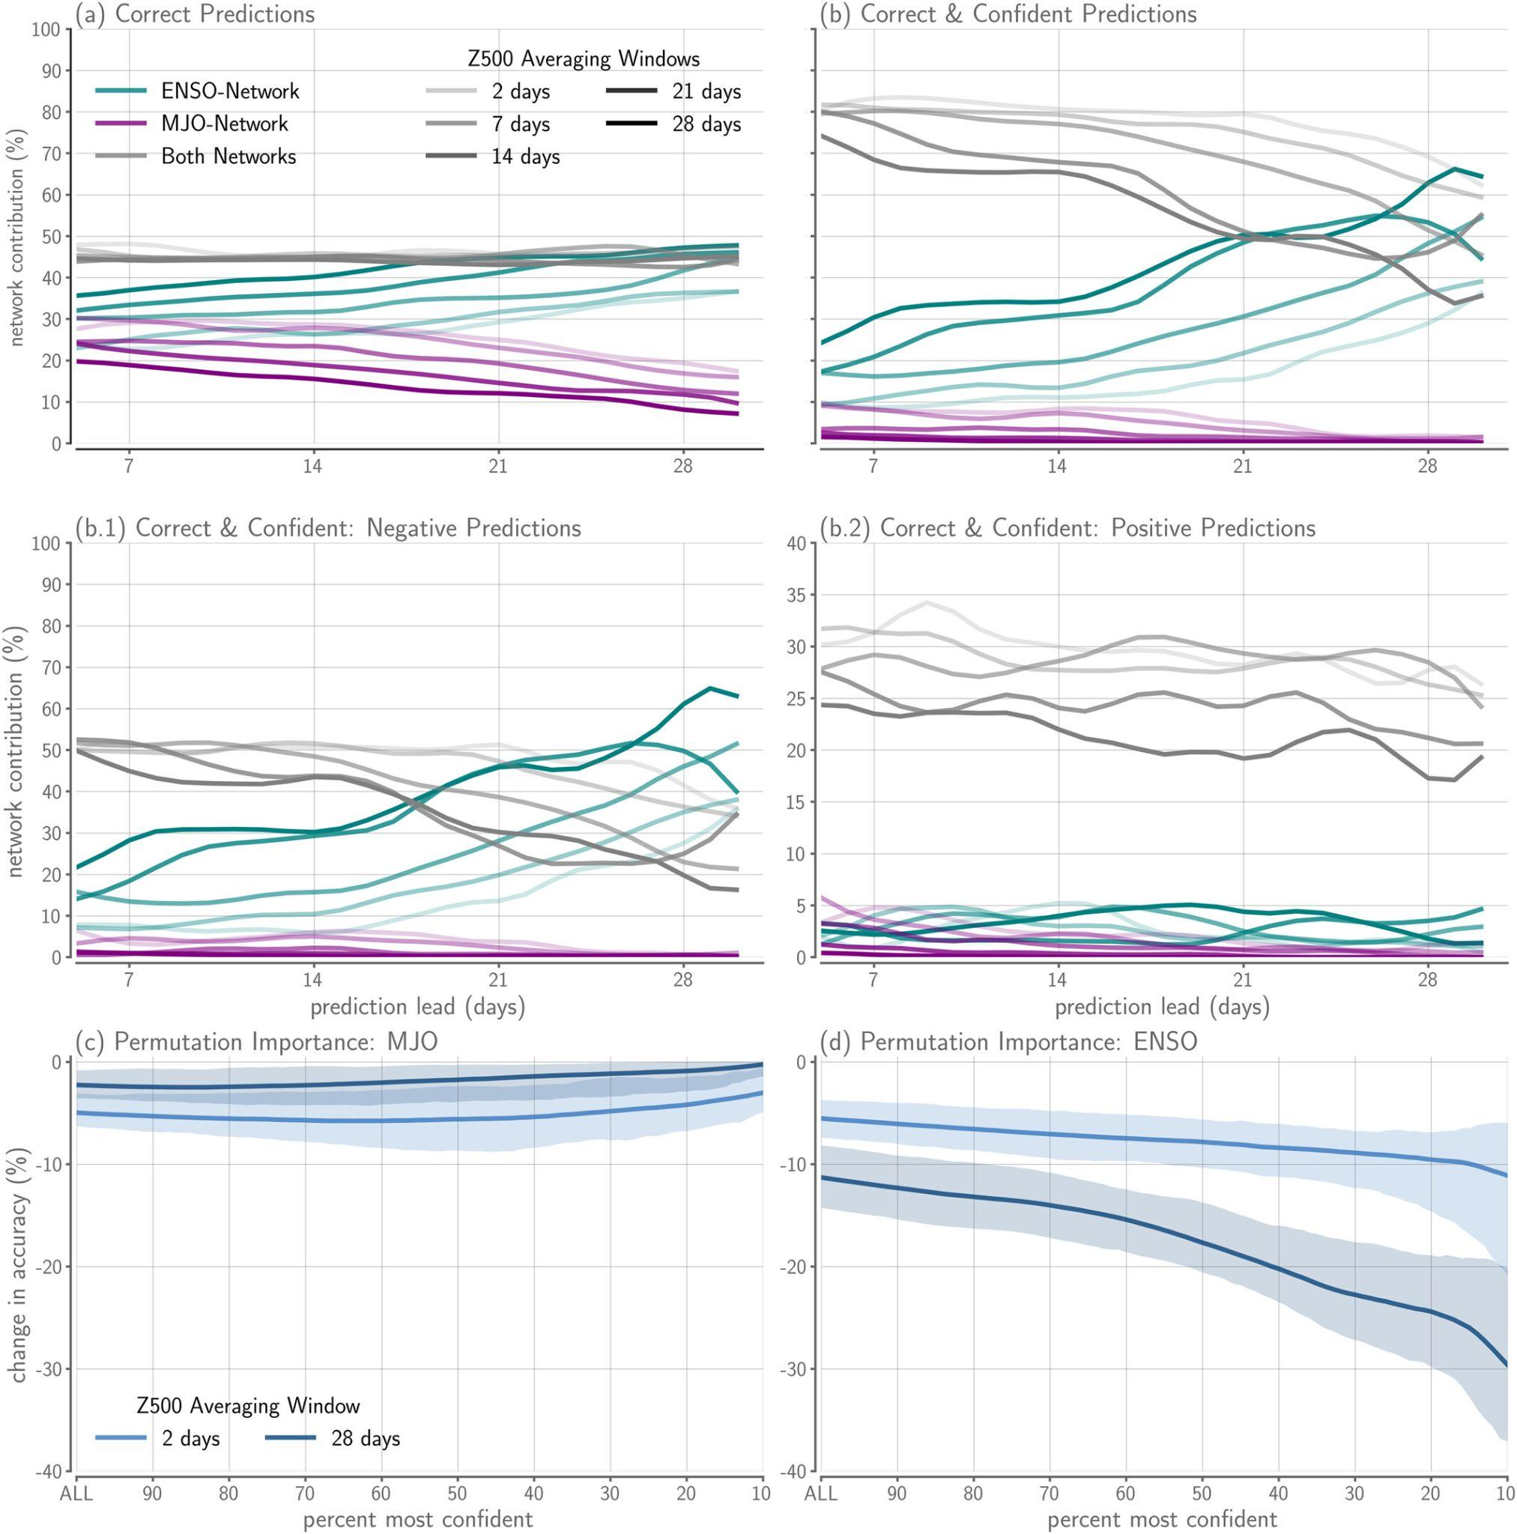
Exploring the relative importance of the MJO and ENSO to North Pacific subseasonal predictability
OBJECTIVE
To separate the relative contribution of two tropical modes of variability to North Pacific subseasonal predictability: the Madden-Julian Oscillation (MJO) and the El Nino Southern Oscillation (ENSO).
APPROACH
We utilize an interpretable neural network to disentangle the relative importance of the state of the MJO and ENSO for subseasonal predictability atmospheric circulation at 500 hPa over the North Pacific in the CESM2 preindustrial simulations. The interpretable model is organized into two individual neural networks whose predictions are linearly combined to make the final prediction of the anomalous circulation sign. The individual neural networks receive information about either the MJO or ENSO to make their prediction before being linearly combined. The network’s predictions can then be decomposed into the respective contributions from the MJO or ENSO.
IMPACT
We find that the state of ENSO alone provides more subseasonal predictive information than the MJO on a variety of subseasonal lead times, particularly during network identified forecasts of opportunity (Figure 3b,d). However, persistent and/or anomalously strong MJO events are sources of predictability during ENSO neutral conditions. In addition, we identify late boreal winter as more predictable than early boreal winter, consistent with previous research.
Modified Figure 3:
The frequency of a correct prediction provided by either the MJO- (purple) or ENSO-network (teal) or by both MJO- and ENSO-networks (gray) for each prediction lead. Lighter (darker) lines indicate shorter (longer) Z500 averaging windows. (b) As in (a) but for forecasts of opportunity (20% most confident predictions). (c,d) Change in accuracy across confidence thresholds after permuting (c) RMM and (d) ENSO index input. The light/dark blue lines represent the mean of a 2 days/28 days Z500 averaging window across all lead times and the associated range of change in accuracy is represented by the shading.
Mayer, K. J., Chapman, W. E., & Manriquez, W. A. (2024). Exploring the relative importance of the MJO and ENSO to North Pacific subseasonal predictability. Geophysical Research Letters, 51, e2024GL108479. https://doi.org/10.1029/2024GL108479.

