Slide 1
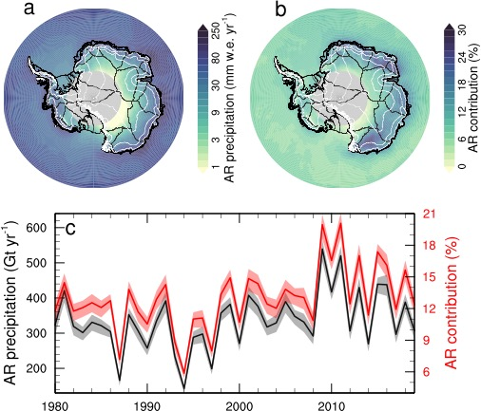
Contribution of Atmospheric Rivers to Antarctic Precipitation
Maclennan, M.L., Lenaerts, J.T.M., Shields, C..A., Wille J.D., (2022). Contribution of Atmospheric Rivers to Antarctic Precipitation. Geophysical Research Letters, 49, e2022GL100585. https://doi.org/10.1029/2022GL100585
OBJECTIVE
Quantify Antarctic precipitation attributable to atmospheric rivers (ARs) collectively and regionally.
(a) 1980–2020 average precipitation attributed to ARs (mm w.e./year); (b) 1980–2020 average relative contribution of AR precipitation to the total annual precipitation; (c) Time series of total AIS (grounded ice sheet and ice shelves) AR precipitation (black, in Gt yr−1), and relative contribution of AR precipitation to total precipitation (in red, in %).
APPROACH
MERRA-2 reanalysis, 3 hourly total (rain + snowfall) precipitation is coordinated with an Antarctic-specific ARDT to identify spatial and temporal AR footprints and quantify precipitation and its variability.
IMPACT
Atmospheric rivers contribute around 13±3% of the total Antarctic Ice Sheet (AIS) precipitation each year. The relative contribution of ARs to precipitation is most substantial in East Antarctica. ARs explain a large fraction (35%) of interannual variability in AIS precipitation.

