Slide 1
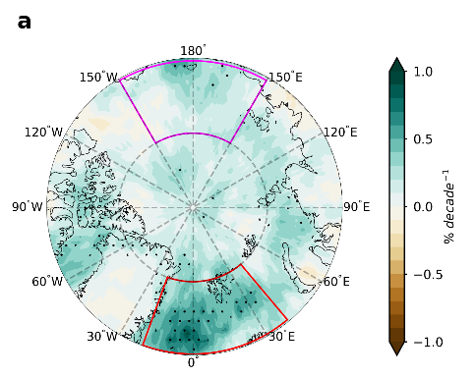
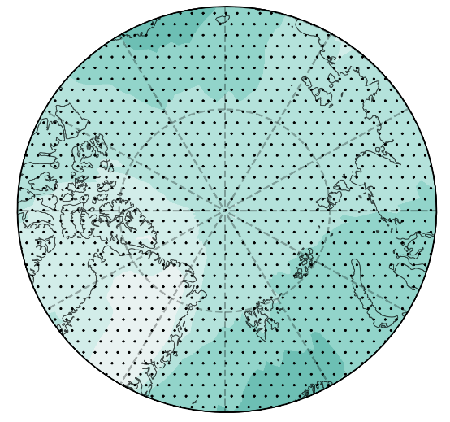
Internal Variability Causes a Spatial Disparity in Arctic Atmospheric Rivers Trends
Objective
Quantify the spatial distribution of trends in the occurrence of Arctic atmospheric rivers (ARs) during 1981-2021.
Understand the role of interdecadal climate oscillations in driving a spatial inhomogeneity of Arctic AR trends.
Approach
Two different reanalysis products are used to quantify and cross-validate the trends of Arctic ARs (1981-2021).
Observed sea surface temperatures are used to characterize modes of climate oscillations.
Ensemble simulations from climate models are employed to disentangle roles of anthropogenic forcing versus internal variability in driving the observed Arctic AR trends.
Impact
Found that the increase of Arctic AR frequency was twice as much over the Atlantic sector as in the Pacific sector, which is not captured by climate models.
Identified the role of phase shifts of different interdecadal climate oscillations in driving the spatial disparity as well as the model-observation discrepancy.
a Observed AR trends
b CMIP6 modeled
Weaker AR trends
Stronger AR trends
Spatial distribution of Arctic atmospheric rivers (ARs) trends during 1981-2021 calculated from (a) ERA5 reanalysis data and (b) CMIP6 multi-model ensemble mean. Significant increases in AR frequency are observed mostly in the Atlantic sector (red box), much stronger than the Pacific sector. The spatial variability is not captured in CMIP6 climate models due to the missing role of interdecadal climate oscillations.
Ma, W., Wang, H., Chen, G. et al. The role of interdecadal climate oscillations in driving Arctic atmospheric river trends. Nat Commun 15, 2135 (2024). https://doi.org/10.1038/s41467-024-45159-5
Notes:
http://www.pnnl.gov/science/highlights/highlights.asp?division=749

