Slide 1
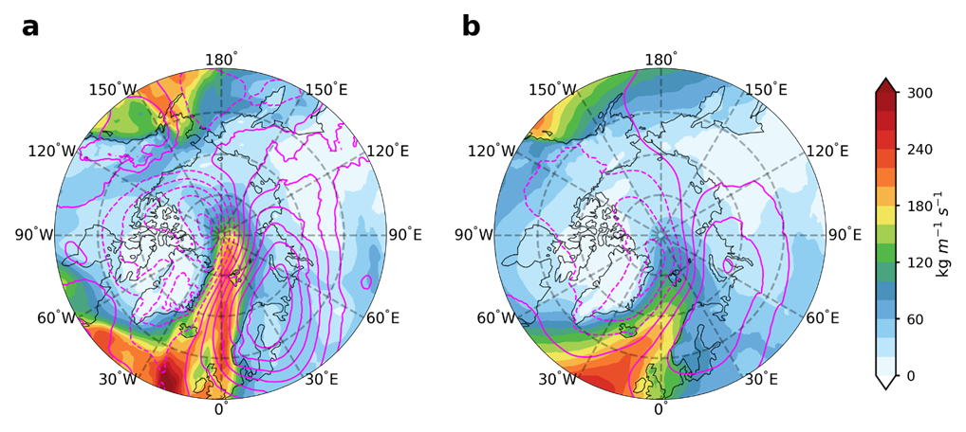
Atmospheric Rivers Increase Winter Heat Extremes in the High Arctic
Objective
Characterize winter heat extremes with surface air temperature above 0 ℃ over the high Arctic (poleward of 80°N) during 1980–2021.
Understand the large-scale weather systems, especially atmospheric rivers (ARs), in driving these extreme warming events.
Approach
Hourly data from reanalysis products are employed to study the characteristics, drivers, and trends of these events.
A popular AR detection algorithm, based on integrated water vapor transport (IVT), is used to identify the presence of ARs.
A composite approach is applied to meteorological fields to investigate the drivers of heat extremes.
Impact
Found that heat extremes with near-surface air temperature above 0 ℃ rarely occur over the high Arctic and that these events were short-lived.
Atmospheric blocking-like structures over northern Eurasia are identified as a key ingredient in driving these events.
All these events, occurring poleward of about 83°N, were associated with ARs.
Composites of IVT (shaded contours) and sea level pressure anomalies (with solid pink lines denoting positive values and dashed lines for negative values) for (a) the days with extreme warming events occurring poleward of 85°N and (b) all the days with ARs intercepting 85°N between 15°W–60°E, but no extreme warming events are found poleward of 85°. Results suggest that ARs steered by the atmospheric blocking structure drove these heat extremes.
Ma, W., Wang, H., Chen, G., Qian, Y., Baxter, I., Huo, Y., and Seefeldt, M. W.: Wintertime extreme warming events in the high Arctic: characteristics, drivers, trends, and the role of atmospheric rivers, Atmos. Chem. Phys., 24, 4451–4472, https://doi.org/10.5194/acp-24-4451-2024, 2024.
Notes:
http://www.pnnl.gov/science/highlights/highlights.asp?division=749

