Slide 1
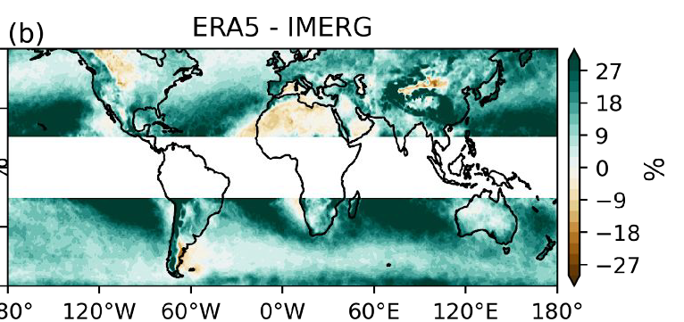
Evaluating the Representations of Atmospheric Rivers and Their Associated Precipitation in Reanalyses With Satellite Observations
Ma, W., Chen, G., Guan, B., Shields, C. A., Tian, B., & Yanez, E. (2023). Evaluating the representations of atmospheric rivers and their associated precipitation in reanalyses with satellite observations. Journal of Geophysical Research: Atmospheres, 128, e2023JD038937. https://doi.org/10.1029/2023JD038937.
Upper Panel: AR precipitation frequency difference between ERA5 reanalysis and IMERG observations.
AR precipitation frequency
OBJECTIVE
Understand atmospheric river precipitation on a global scale using not only reanalysis but satellite observations.
APPROACH
An AR detection algorithm specifically for satellite observations using moisture and the geostrophic winds is derived from 3D geopotential height field from combined retrievals of the Atmospheric Infrared Sounder and the Advanced Microwave Sounding Unit on NASA Aqua satellite. We also create the first global AR catalog based solely on satellite observations. The satellite-based AR catalog is combined with the satellite-based precipitation to evaluate the representations of ARs and AR-induced precipitation in reanalysis products.
Lower Panel: AR precipitation intensity difference between ERA5 reanalysis and IMERG observations.
AR precipitation intensity
IMPACT
The findings of this study can help to improve the representations of ARs and associated precipitation in reanalyses and climate models.

