Slide 1
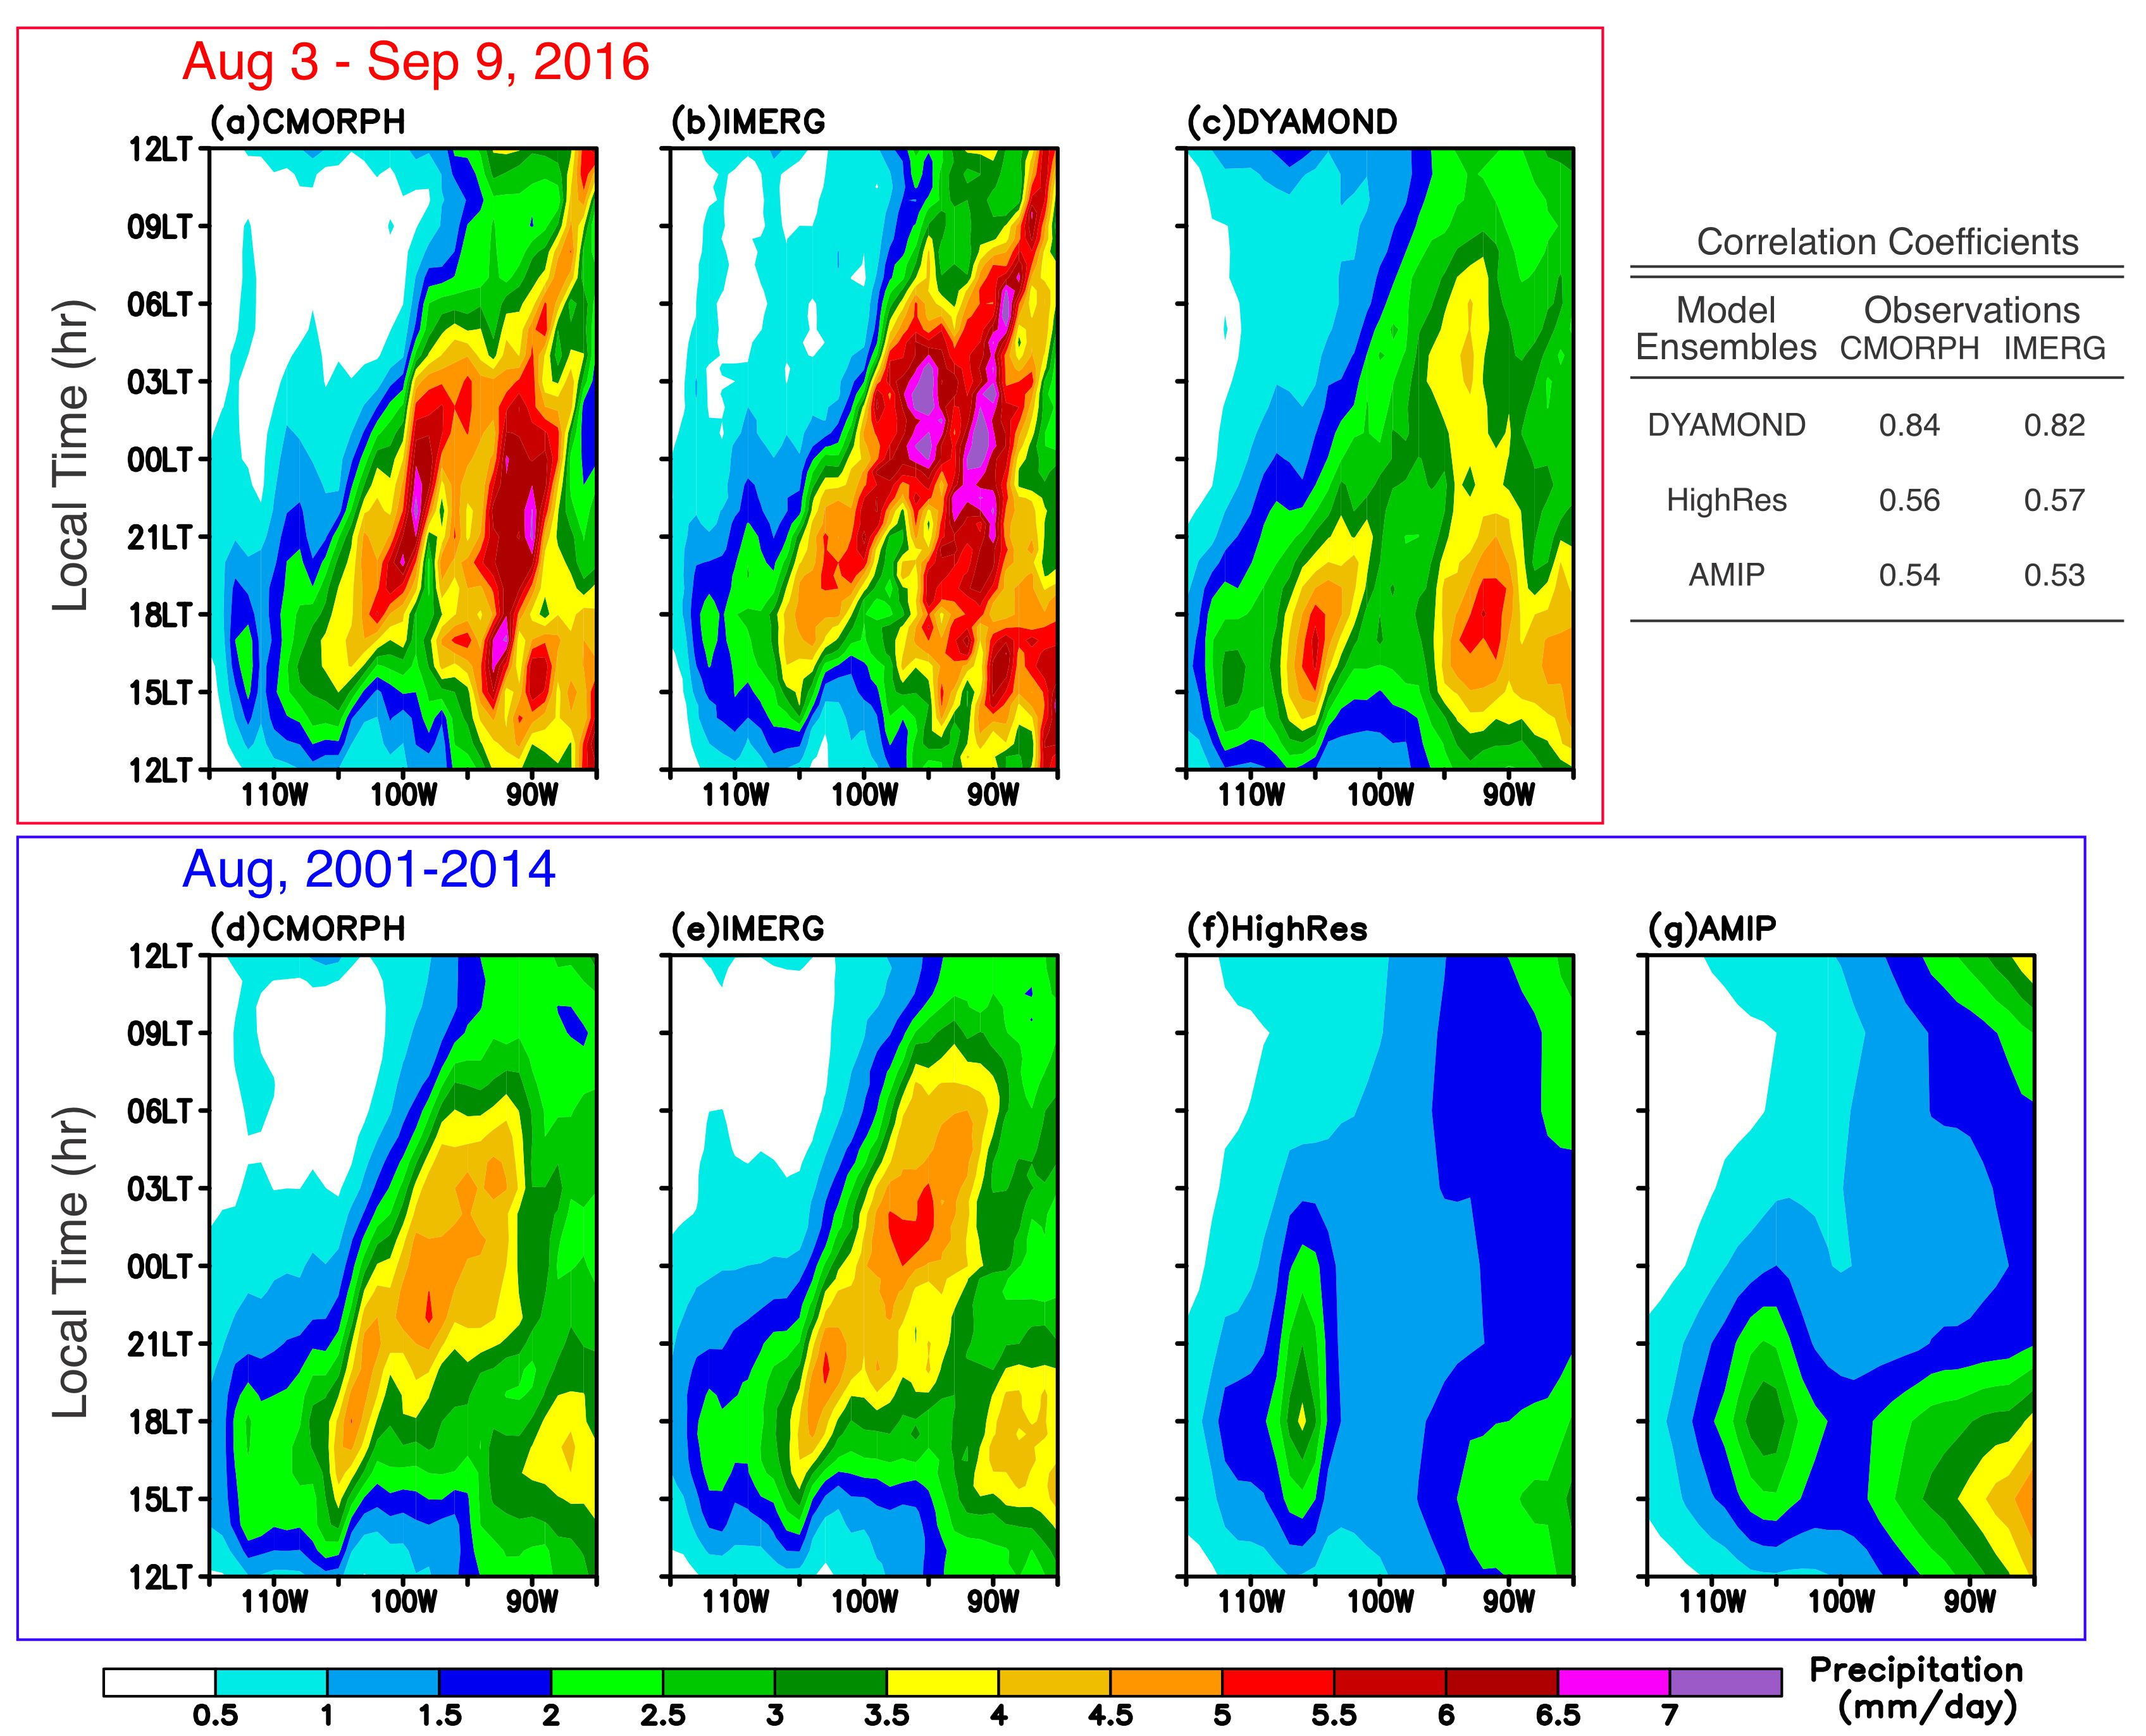
Superior daily and sub-daily precipitation statistics for intense and long-lived storms in global storm-resolving models
RGMA
Science Questions
What aspects of precipitation simulations are better captured by global storm-resolving models (GSRM, DYAMOND project) compared to other CMIP-class models (CMIP6 HighResMIP and AMIP), and what problems remain?
Key Accomplishments
Daily and sub-daily precipitation statistics from GSRMs and coarser resolution global models are compared to observations
GSRMs show superior performance for statistics of more intense precipitation events including their diurnal cycle and spatial propagation
GSRMs are not superior for statistics of weaker or shorter duration precipitation.
Diurnal Cycle of Precipitation over Central US
Ma, H.-Y., Klein, S. A., Lee, J., Ahn, M.-S., Tao, C., & Gleckler, P. J. (2022). Superior daily and sub-daily precipitation statistics for intense and long-lived storms in global storm-resolving models. Geophy. Res. Lett., 49, e2021GL096759. https://doi.org/10.1029/2021GL096759
Multi-model mean (MMM) from DYAMOND models (GSRMs) shows capability to simulate the propagation of convection but it is generally absent in the CMIP6 HighRes and AMIP models.

