Slide 1
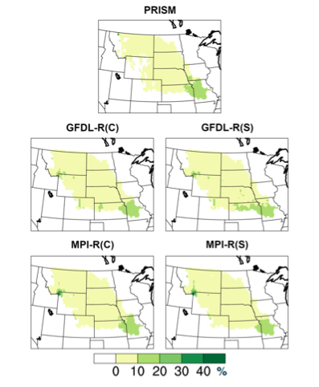
Contemporary and Future-Scenario Substantial-Precipitation Events in the Missouri River Basin
Scientific Challenge
The Missouri River Basin is the largest single river basin in the U.S. and plays an important role in many natural and human systems. Extended (≥30-day) and short-term (≥5-day) periods of substantial precipitation can be climate-impact drivers that affect the economic activities of the region. There have been few comprehensive studies of the hydroclimate of this basin, even though the basin experiences substantial drought and flooding variability
Approach and Findings
We diagnose events using an object-oriented methodology applied to PRISM observations and two sets of contemporary (1981-2000) and RCP8.5 scenario (2041-2060) simulations by RegCM4 for the North America CORDEX program. Frequencies and durations of simulated contemporary and scenario events are nearly the same as PRISM’s. About half of the extended-period events have an embedded short-term event; that half generally has much larger areas, longer durations and more intense precipitation compared to the other half. Frequencies, areas, durations and spatial distributions of the extended-period and short-term events change little between contemporary and scenario climates.
Figure
Significance and Impact
The characteristics of these events in observations and climate-change simulations can guide the basin’s water is management future climate. Highest frequencies are concentrated to the southeastern end of the basin, closest to the Gulf of Mexico. Events occur primarily during April–September indicating when flooding might occur due to periods of substantial rainfall. The amplification of extended-period events by embedded short-term events should be useful for water managers assessing the evolution periods with substantial precipitation.
The spatial distribution of event frequency at each anal-ysis grid point, given as the % time a grid point is con-tained in an extended-period event. Upper row: PRISM frequencies. Middle row: GFDL-RegCM4 frequencies (contemporary left, scenario right). Bottom row: like the middle row but for MPI-RegCM4 frequencies.
Fisel, B. J., N. E. Erickson, C. R. Young, A. L. Ellingworth and W. J. Gutowski, Jr., 2023: Evaluating Contemporary and Future-Scenario Substantial-Precipitation Events in the Missouri River Basin using Object-Oriented Analysis. Climate, https://doi.org/10.3390/cli11050112.
Biological and Environmental Research
Notes:
Word highlight text here.

