Slide 1
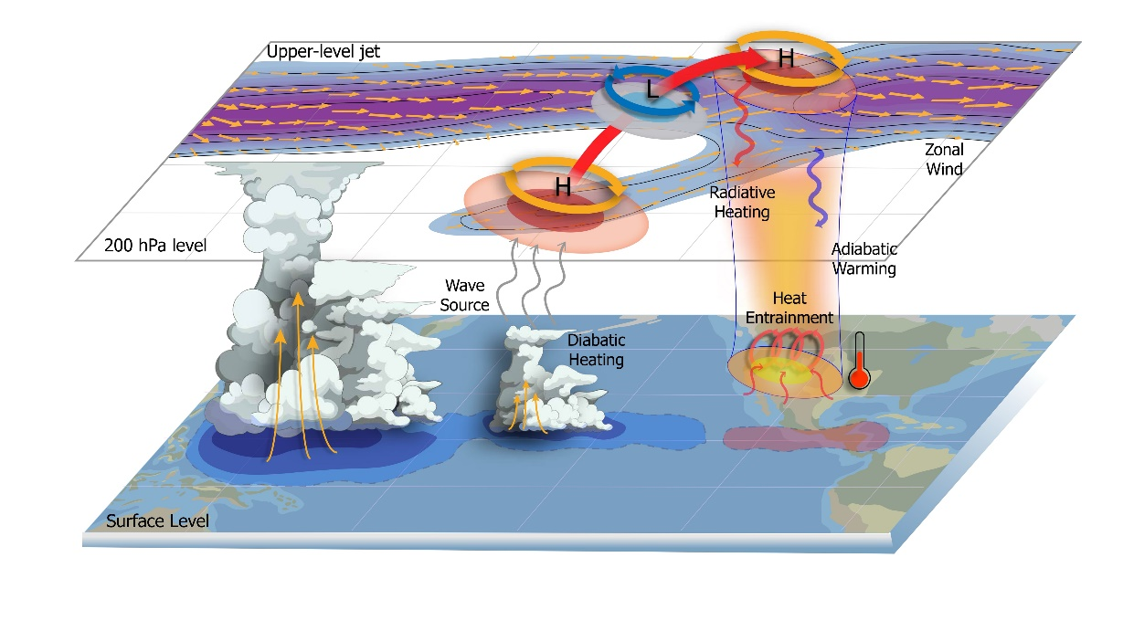
Tropical Weather Exacerbates Heat and Wildfire Threats in the Pacific Northwest
Objective
To investigate the boreal summer instraseasonal oscillation’s (BSISO) teleconnection impacts on heatwaves and fire risks in the Pacific Northwest region (PNW) and identify the key dynamical processes driving this remote influence.
Approach
We utilize the linear baroclinic model to identify the dominant forcing responsible for heatwave formation. This is achieved through a series of idealized experiments with three-dimensional BSISO forcing applied over various tropical ocean basins, and by considering a summertime zonally asymmetric basic state.
To validate the teleconnection mechanism, we apply Rossby wave ray tracing techniques, along with the wave activity flux and the Rossby wave source analysis.
Impact
The occurrence of heat extremes and fire risks in the PNW is significantly heightened by approximately 50 – 120% (2.2 times the seasonal probability) during BSISO phases 6-7.
Sensitivity experiments using the linear baroclinic model and Rossby wave ray tracing analysis identify that diabatic heating from the tropical eastern North Pacific as the dominant driver.
Improving the representation of BSISO heating over the tropical eastern North Pacific in weather and climate models could enhance forecasts of heatwaves and wildfire risks in the PNW weeks to months in advance.
Enhanced diabatic heating over the tropical central-to-eastern North Pacific during BSISO phases 6-7 strengthens Rossby wave sources, inducing a Rossby wave train that propagates downstream over the North America (schematic on the left). As a result, the upper tropospheric ridge in the PNW intensifies, leading to surface warming through increased solar radiation and enhanced adiabatic subsidence. This condition results in the probability of heatwaves rising to double the seasonal average over the region (figure on the right).
Lubis, S.W., et al. 2024. “Enhanced Pacific Northwest heat extremes and wildfire risks induced by the boreal summer intraseasonal oscillation”. npj Clim Atmos Sci 7, 232. [DOI: 10.1038/s41612-024-00766-3}

