Slide 1
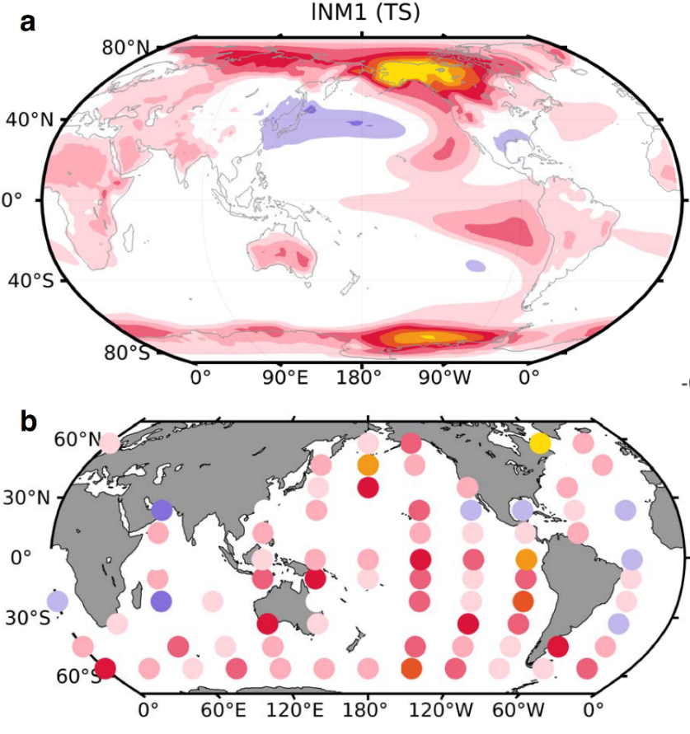
The Sweet Spot for Cooling the Global Climate
Objective
To pin down the locations where an energy source is most efficient in driving global mean warming.
Approach
Conduct a large set of Green’s function experiments, in which ocean heat flux patches are applied one patch at a time, using the Community Atmosphere Model (CAM5) coupled to a slab ocean.
Make use of the forcing-response relationship encapsulated by linear response function (LRF).
Estimate LRF using the response to the Green’s function experiments.
Impact
The singular value decomposition of LRF extracts the most excitable modes of the climate system examined; it also pairs up the pattern of the modes with their corresponding optimal forcing patterns.
The work can be extended to provide valuable insights on the optimal forcing location to cool the global climate and to understand regional climate response and feedback.
This shows the leading neutral mode of the slab-coupled CAM5. Figure (a) is a manifestation of the mode in global surface temperature; Figure (b) shows its corresponding optimal forcing pattern. Note that the leading mode projects most strongly on global mean temperature and accounts for the most variance in the response to the forcing from different locations.
Lu J, F Liu, LR Leung, and H Lei. 2020. “Neutral modes of surface temperature and the optimal ocean thermal forcing for global cooling.” npj Clim Atmos Sci, 3: 9, DOI: 10.1038/s41612-020-0112-6.
Notes:
http://www.pnnl.gov/science/highlights/highlights.asp?division=749

