Slide 1
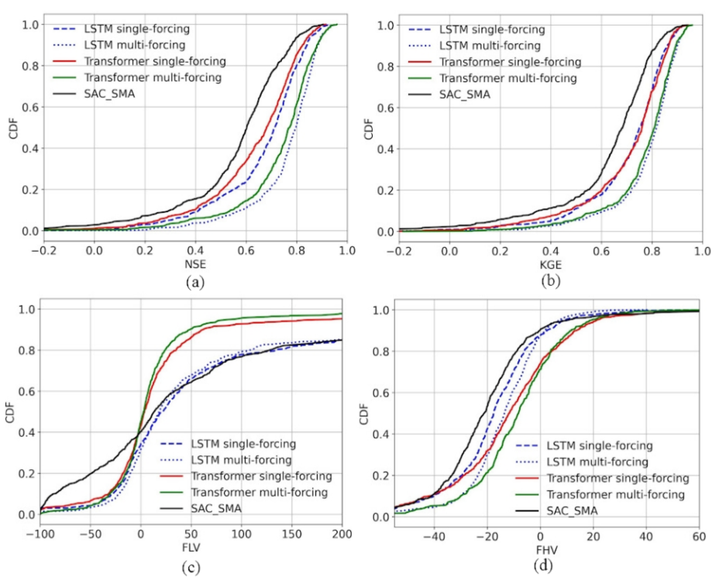
Probing the limit of hydrologic predictability with the Transformer network
Objective
Determine whether the popular Transformer deep learning architecture might be able to improve hydrological predictions beyond the ability of Long Short-Term Memory (LSTM), the current top hydrological deep learning model architecture.
Approach
Basic Transformer, modified (recurrence-free) Transformer, and LSTM models were trained and tested for streamflow prediction across 671 US basins
Impact
The basic Transformer deep learning model architecture was not suitable for hydrologic modeling
The modified (recurrence-free) Transformer architecture was a rare competitive architecture to LSTM. As a non-recurrent model, the Transformer may bear scale advantages for learning from bigger datasets and storing knowledge.
The performance of these state-of-the-art models may be close to the prediction limits of the dataset. We suspect that unless we bring in new information, it is highly unlikely for any other models to produce noticeable advantages beyond these two models on this dataset, for the tests presented here. Errors with forcings, basin shapes, attributes, and discharge data are likely the remaining factors preventing higher performance.
Comparative analysis of Cumulative Density Function (CDF) across various models including Long Short-Term Memory (LSTM) and modified Transformer deep learning models, and the conceptual Sacramento Soil Moisture Accounting (SAC-SMA), with units in mm/dayand one specific seed (rather than a random seed). The model encompasses single and multi-forcing data for models. The figure depicts the following comparisons: (a) Nash-Sutcliffe Efficiency (NSE) vs CDF, (b) KlingGupta Efficiency (KGE) vs CDF, (c) Low flow percent bias (FLV) vs CDF, and (d) High flow percent bias (FHV) vs CDF. Single-forcing models were implemented on a set of 671 basins in the CAMELS dataset, whereas multi-forcing models were applied to a subset of 531 basins from that dataset.
Liu, J., Bian, Y., Lawson, K., & Shen, C. (2024). Probing the limit of hydrologic predictability with the Transformer network. Journal of Hydrology, 637, 131389. https://doi.org/10.1016/j.jhydrol.2024.131389

