Slide 1
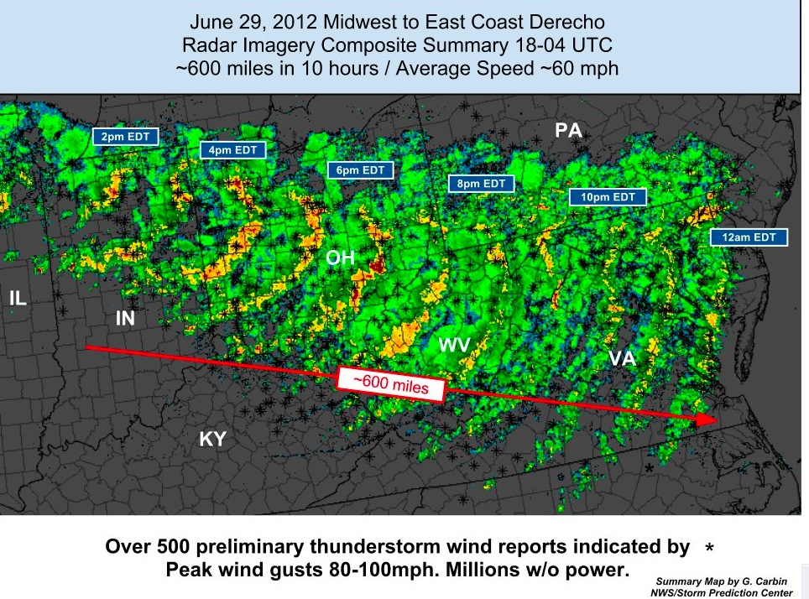
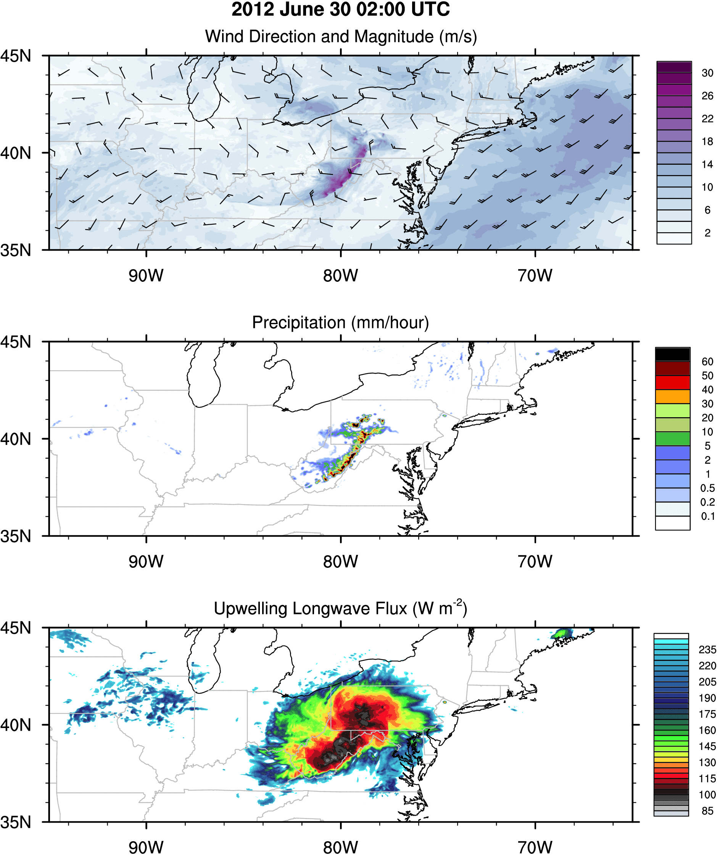
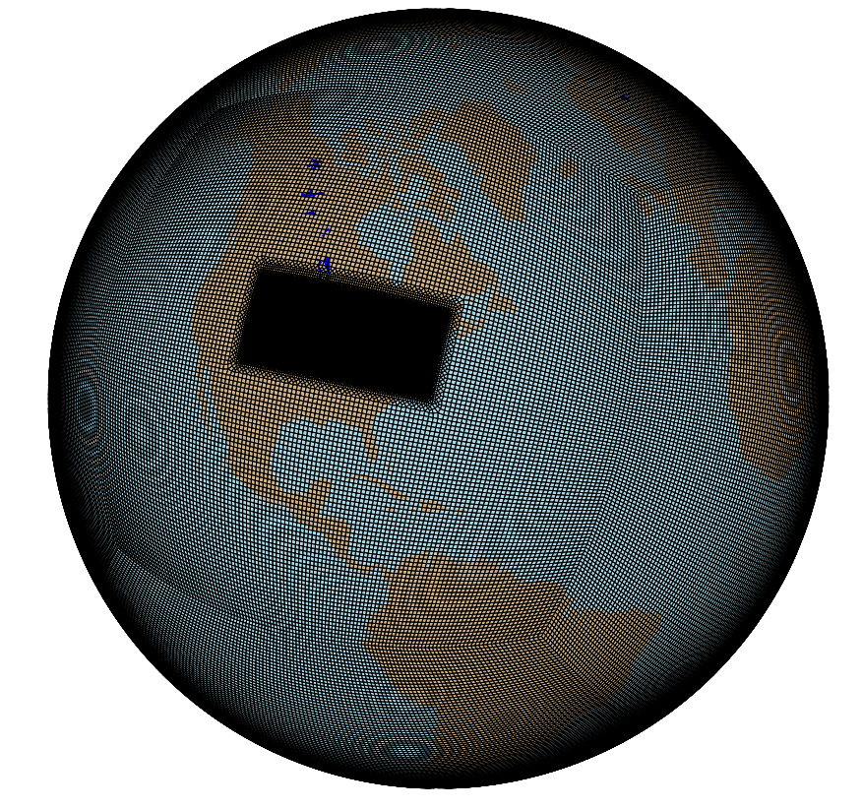

The June 2012 North American Derecho:
A Testbed for Regional and Cloud-System Resolving Models
Objective
The June 2012 North American Derecho delivered extreme winds and heavy precipitation to much of the U.S. Northeast, leaving devastation in its wake. This study demonstrates the feasibility of simulating the 2012 North American Derecho in the regionally-refined Simple Cloud Resolving E3SM Model (SCREAM) and proposes a testbed based on this historically impactful event.
Approach
A set of metrics and diagnostics based on the observed 2012 North American Derecho has been developed for intercomparing model simulations. This historically impactful storm was simulated in SCREAM at 1.6km, 3.25km and 7.5km grid spacing over its historical path, and in the Weather Research and Forecasting (WRF) model at 3.25km. Results showed that SCREAM is comparable in performance to WRF for this event, despite being a global climate model.
Impact
E3SM/SCREAM has immense potential for simulating historic extreme weather events and their future analogs. This study successfully demonstrated how it can be used for studying similar local-to-regional-scale high-impact extremes.
(Top Left) The radar composite of the derecho event as it moved from Illinois to the East Coast. (Bottom Left) The regionally refined SCREAM grid used for simulating the event. (Right) A snapshot of the simulated storm on 2012 June 30 at 02:00 UTC.
Liu, W., P.A. Ullrich, J. Li, C. Zarzycki, P.M. Caldwell, L.R. Leung and Y. Qian (2023) “The June 2012 North American Derecho: A testbed for evaluating regional and global climate modeling systems at cloud-resolving scales” J. Adv. Model. Earth Sys. 15 (4), e2022MS003358, doi: 10.1029/2022MS003358.

