Slide 1
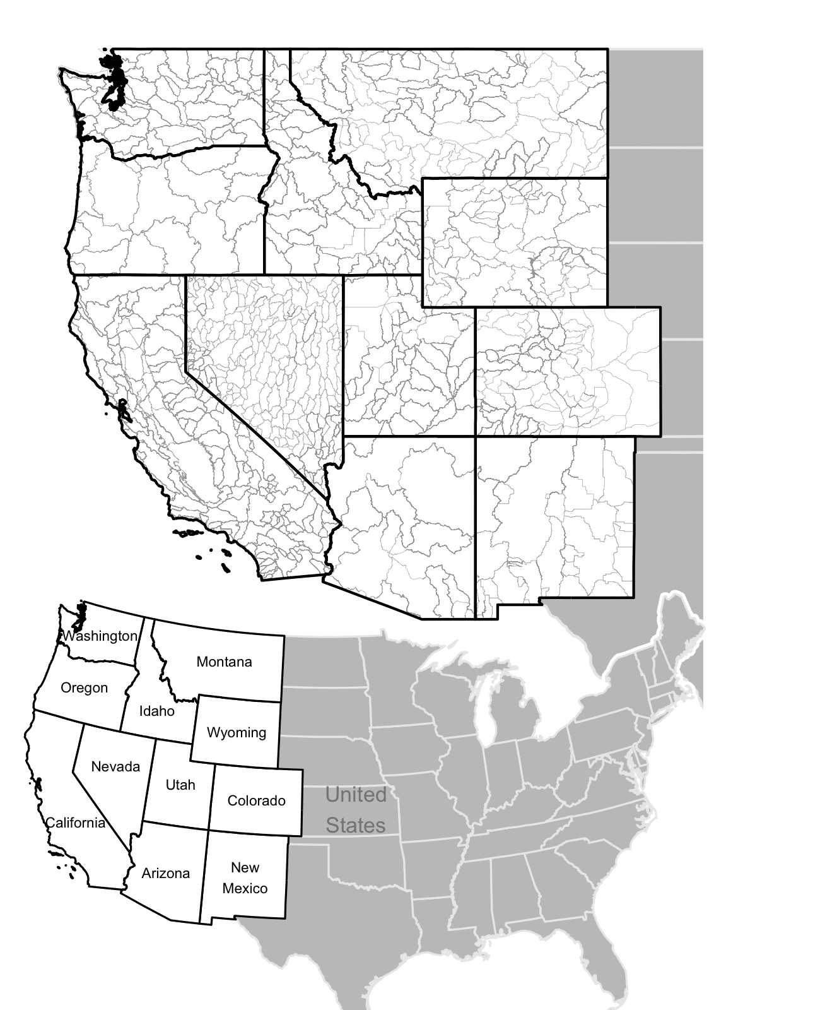
Harmonized Database of Western U.S. Water Rights (HarDWR) v.1
Objective
To understand and address the challenges of the current water rights system, researchers require accessible water rights data for fields such as hydrology, water management, conservation, climate change, and natural resource economics. Individual states in the U.S. West supply water rights data, but it comes in a variety of formats and categorization methods, necessitating a search of individual databases or a request for data access from state regulatory agencies. We aimed to collect water rights records, harmonize them into a consistently formatted database, and make this database available for more comprehensive regional analyses.
Approach
Raw water rights data were collected from each state in the Western U.S. The records were harmonized into a single consistent format. Approximations were used to address some inconsistencies between states, e.g. Arizona and pumping capability or New Mexico and pump installation date. Rights records were then totaled by state-defined water management areas and by year.
Impact
We present a new database of Western U.S. water rights records (HarDWR), featuring consistent identifiers for water management units and water rights records, and a categorization scheme for broad use categories. Developed for a study on intersectoral water allocation through water markets, this database is designed for use with the Water Balance Model (WBM) and is publicly available to support further research on U.S. Western water management.
Figure: Two maps to highlight the states in which water rights were collected from, and the state defined water management areas.
Lisk, M.D., Grogan, D.S., Zuidema, S., Zheng, J., Caccese, R., Peklak, D., Fisher-Vanden, K., Lammers, R., Olmstead, S., Fowler, L. Harmonized Database of Western U.S. Water Rights (HarDWR) v.1. Sci Data 11, 598 (2024). https://doi.org/10.1038/s41597-024-03434-6

