Slide 1
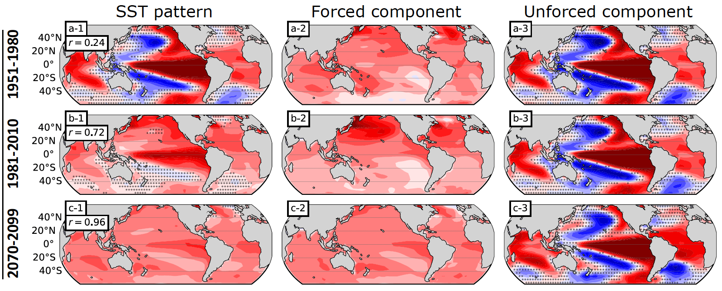
The relative importance of forced and unforced temperature patterns in driving the time variation of low-cloud feedback
Science Question
How do forced versus unforced SST patterns conspire to drive temporal variations in the low-cloud feedback?
Key Accomplishments
The team found that the relative importance of the forced and unforced feedback components changes through time.
Unforced SST variations associated with ENSO dominate dominate prior to about 1980 while anthropogenically-forced SST signals dominate thereafter.
Impact
The team showed that the shift towards a more stabilizing low-cloud feedback in recent decades is due to the forced signal increasingly emerging from the noise of natural climate variability.
Overall SST pattern (left), the forced component (middle), and the unforced component (right) calculated from three different 30-year windows (rows) in the CESM large ensemble. The overall SST pattern transitions from being dominated by the unforced component in 1951-1980 to being dominated by the forced component by 2070-2099.
Lin, Y.-J., G. V. Cesana, C. Proistosescu , M. D. Zelinka, and K. C. Armour, 2024: The relative importance of forced and unforced temperature patterns in driving the time variation of low-cloud feedback, J. Climate, doi:10.1175/JCLI-D-24-0014.1.
Notes:
The Science
Scientists at Columbia University in collaboration with scientists at PCMDI and elsewhere determined the reasons for temporal variations in the strength of the cloud feedback. They found that the relative importance of the forced and unforced feedback components changes through time: Unforced sea surface temperature (SST) variations associated with El Nino Southern Oscillation (ENSO) – which lead to weak low-level stability and less-stabilizing cloud feedback – dominate dominate prior to about 1980. Thereafter, anthropogenically-forced SST signals dominate. These are characterized by relatively uniform warming that is enhanced in the West Pacific, leading to a more-stabilizing low-cloud feedback.
The Impact
Low-cloud feedback is sensitive to the pattern of warming, which differs between unforced climate variability and anthropogenically forced climate change. The team showed that the shift towards a more stabilizing low-cloud feedback in recent decades is due to the forced signal increasingly emerging from the noise of natural climate variability.
Summary
Atmospheric models forced with observed sea-surface temperatures (SSTs) suggest a trend toward a more-stabilizing cloud feedback in recent decades, partly due to the surface cooling trend in the eastern Pacific (EP) and the warming trend in the western Pacific (WP). Here we show model evidence that the low-cloud feedback has contributions from both forced and unforced feedback components, and that its time variation arises in large part through changes in the relative importance of the two over time, rather than through variations in forced or unforced feedbacks themselves. Initial condition large ensembles (LEs) suggest that the SST patterns are dominated by unforced variations for 30-year windows ending prior to the 1980s. In general, unforced SSTs are representative of an ENSO-like pattern, which corresponds to weak low-level stability in the tropics and less-stabilizing low-cloud feedback. Since the 1980s, the forced signals have become stronger, outweighing the unforced signals for the 30-year windows ending after the 2010s. Forced SSTs are characterized by relatively uniform warming with an enhancement in the WP, corresponding to a more-stabilizing low-cloud feedback in most cases. The time-evolving SST pattern due to this increasing importance of forced signals is the dominant contributor to the recent stabilizing shift of low-cloud feedback in the LEs. Using single-forcing LEs, we further find that if only greenhouse gases evolve with time, the transition to the domination of forced signals occurs 10-20 years earlier compared to the LEs with full forcings, which can be understood through the compensating effect between aerosols and greenhouse gases.

