Slide 1
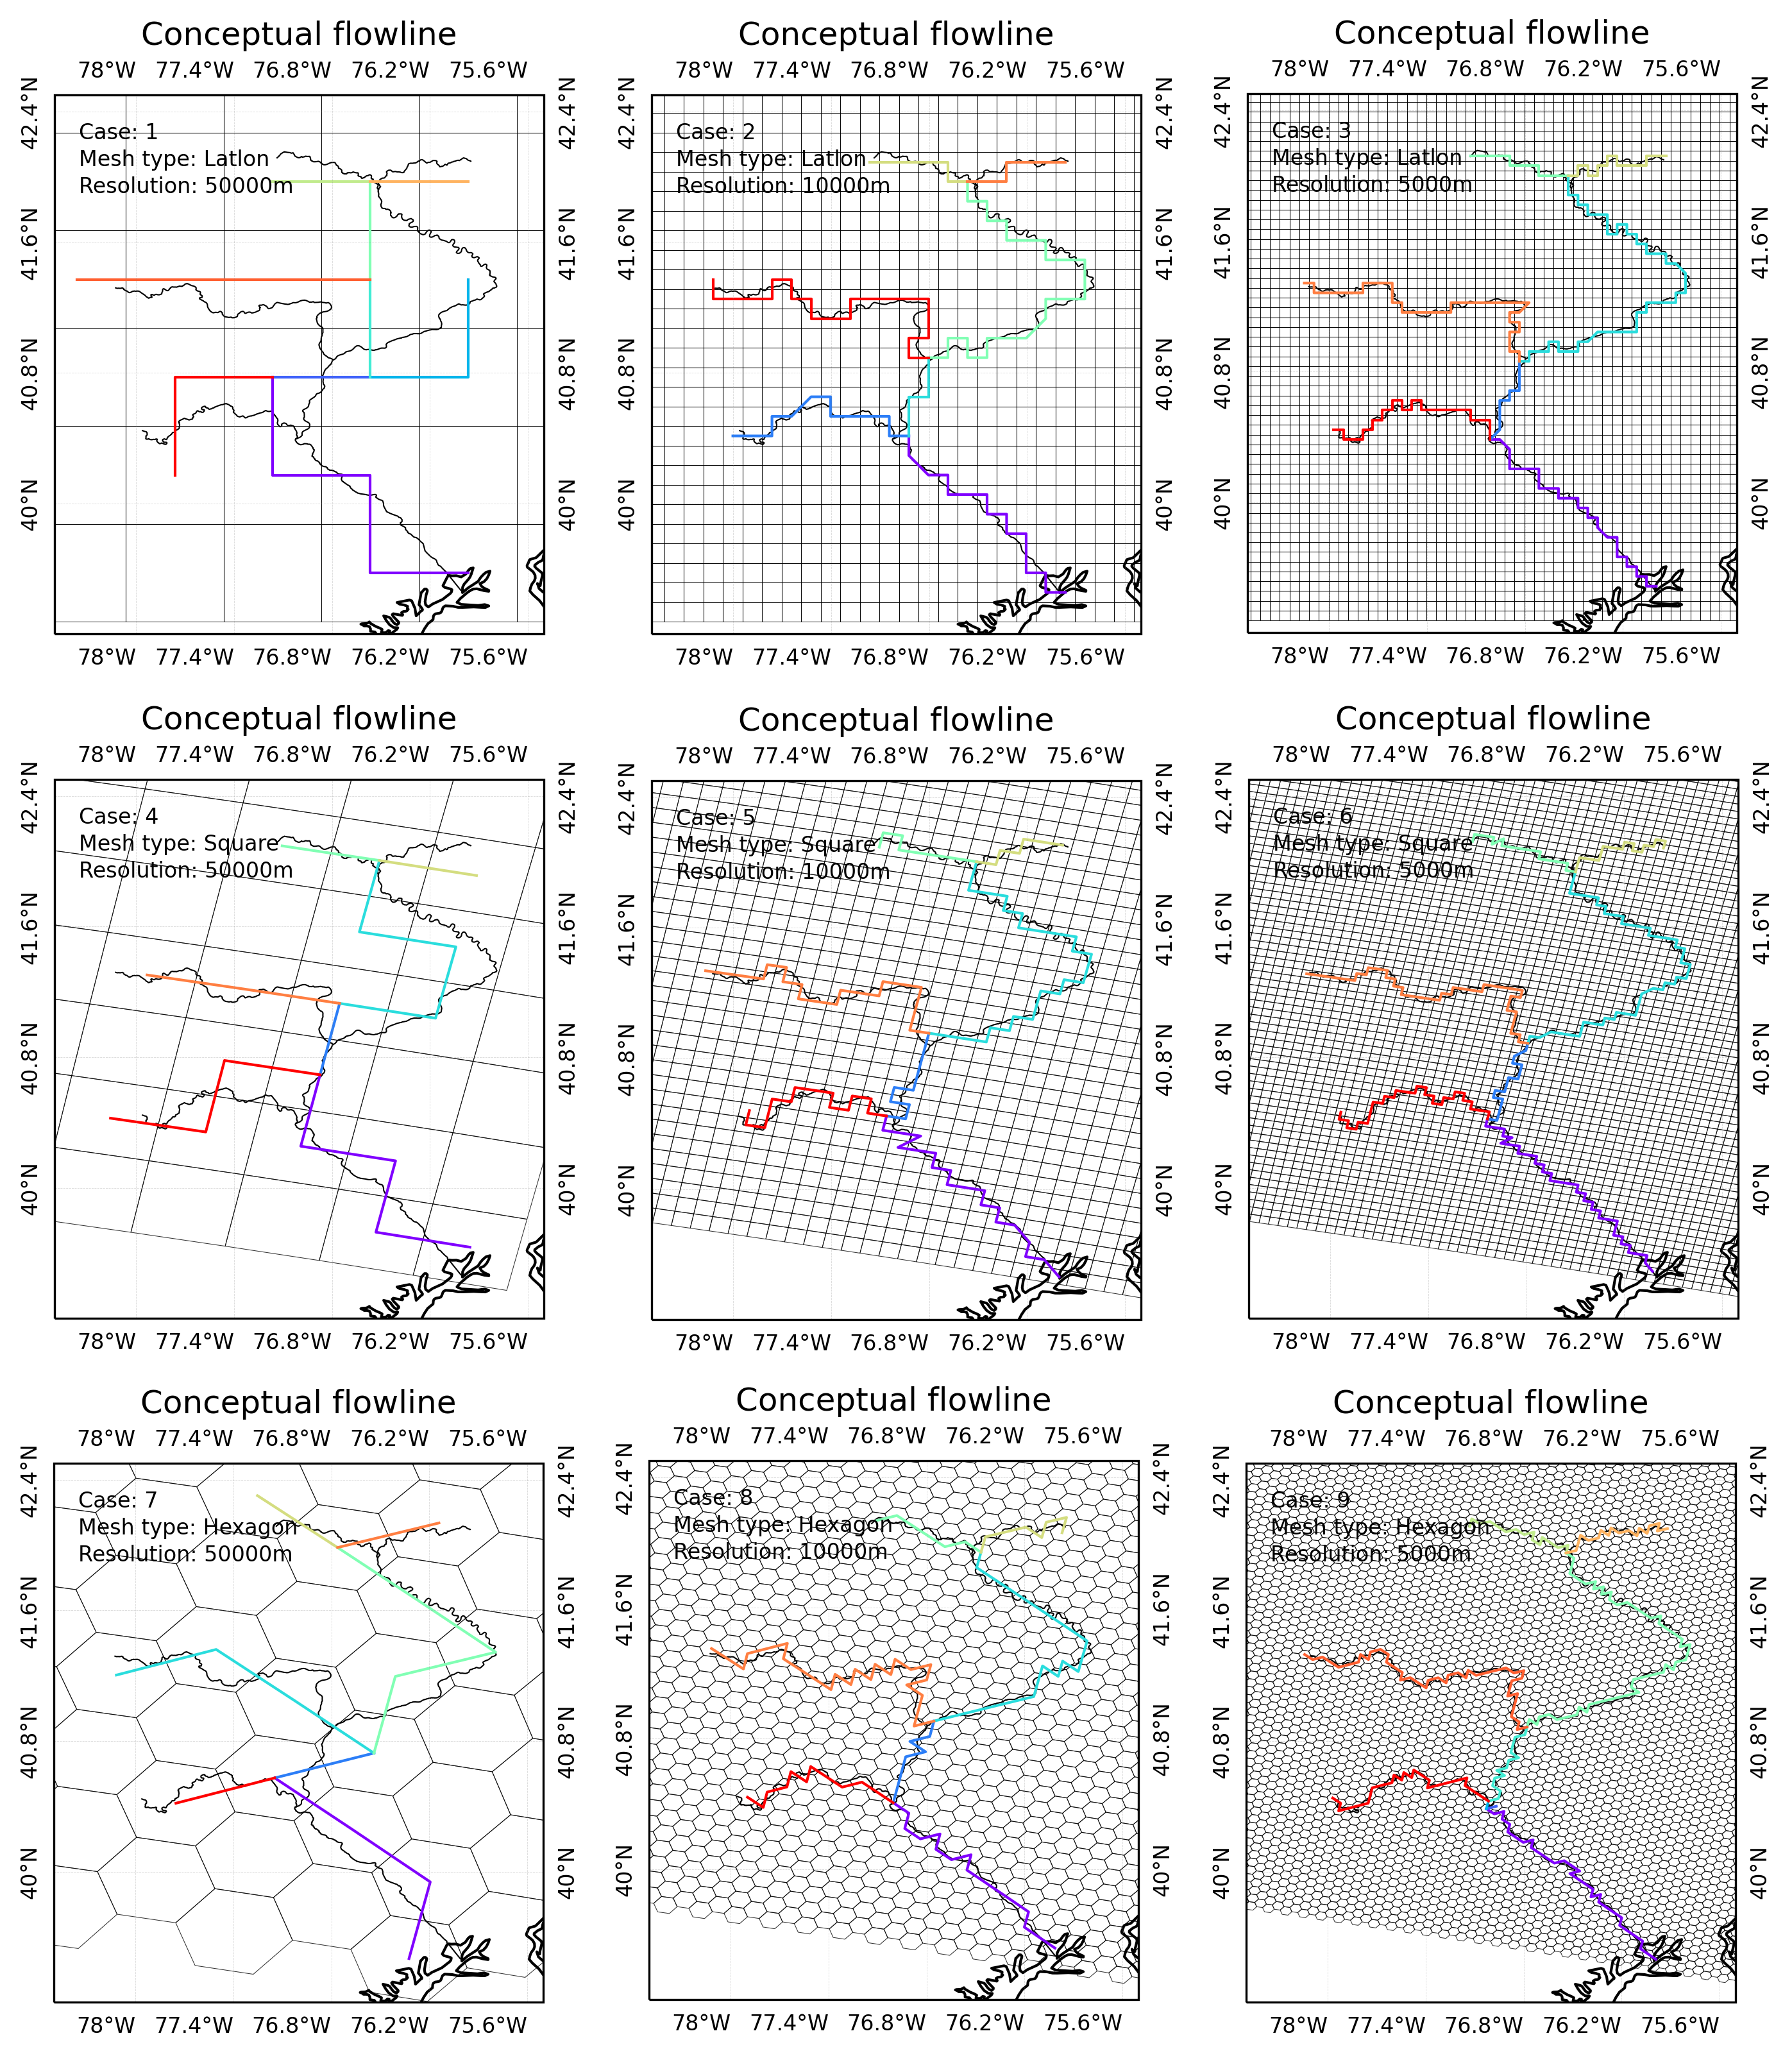
Using Topological Relationships in Mesh-Independent River Network Representations
Objective
Develop a model that enables high-fidelity river network representations in any mesh system.
Approach
Use graph theory algorithms to simplify real-world river networks.
Develop a topological relationship-based river network representation method.
Evaluate model performance under multiple configurations and observational inputs.
Impact
The first-of-its-kind method allows river network representation in any mesh system.
The new method lays the foundation for an advanced stream-burning and depression-filling algorithm to perform flow direction modeling in both hydrologic and Earth system models.
With the topological relationship-based method, the model can represent river networks in any mesh system and resolution. Top to bottom, the rows represent different meshes (lat-long, projected, and hexagon). Left to right, the columns represent different cell resolutions (50, 10, and 5 km). Black and colored lines are real and conceptual river networks.
Liao, C., Zhou, T., Xu, D., Cooper, M. G., Engwirda, D., Li, H.-Y., & Leung, L. R. ”Topological relationship-based flow direction modeling: Mesh-independent river networks representation.” Journal of Advances in Modeling Earth Systems, 15, e2022MS003089 (2023). [DOI: 10.1029/2022MS003089]

