Slide 1
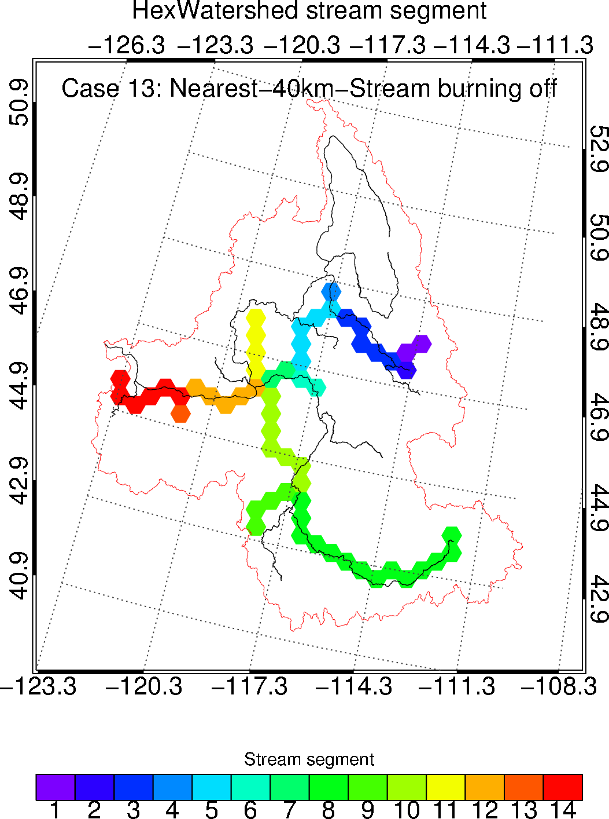
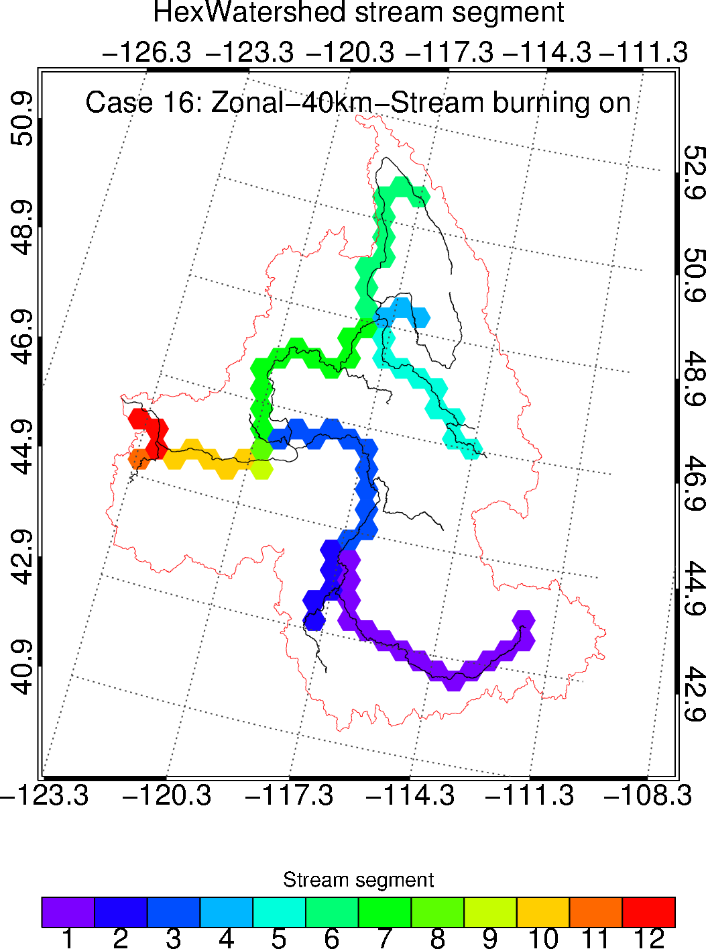
Representing River Networks in an Unstructured Mesh Framework
Objective
Improve an existing watershed delineation model to consider river networks in a hexagonal mesh.
Approach
Add new features, including zonal resampling and stream burning algorithms, into the model.
Seamlessly couple the new features with the existing depression filling algorithm.
Evaluate the model performance under various configurations and observational inputs.
Impact
The additional capabilities allow the model to consistently represent river networks at any spatial resolution.
The new approach paves a path for an advanced hybrid stream burning and depression filling algorithm for use in flow direction modeling and Earth system models.
With the stream burning feature turned on (right), the HexWatershed model significantly improves the river network representation compared with when it is off (left).
Liao, C., Zhou, T., Xu, D., Barnes, R., Bisht, G., Li, H.-Y., Tan, Z., Tesfa, T., Duan, Z., & Engwirda, D. “Advances in hexagon mesh-based flow direction modeling,” Advances in Water Resources, 104099, (2022). [DOI: 10.1016/j.advwatres.2021.104099]

