Slide 1
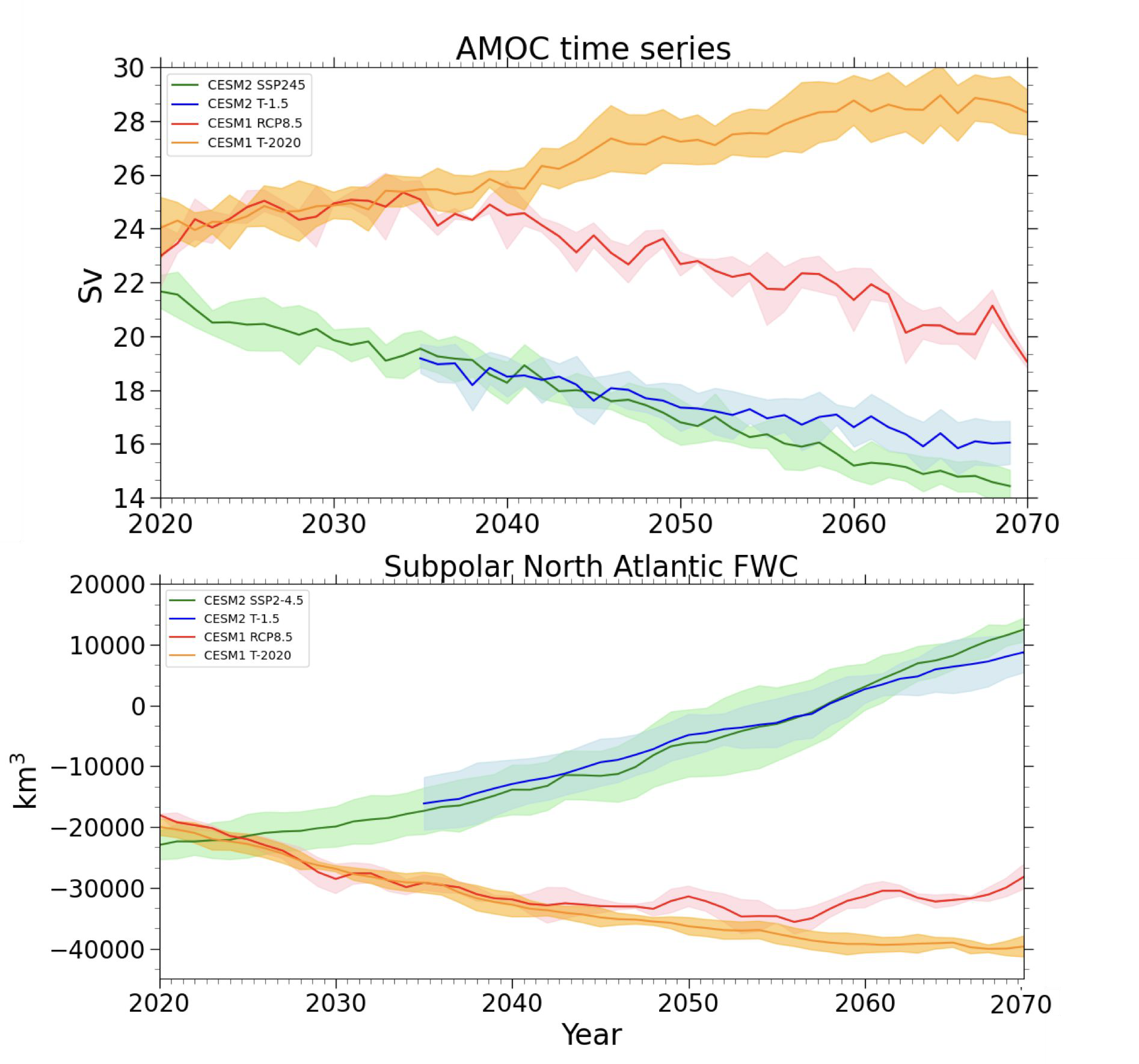
Responses in the subpolar North Atlantic in two climate model sensitivity experiments with increased stratospheric aerosols
Li, H., J. H. Richter, A. Hu, G. A. Meehl, and D. MacMartin, 2023: Responses in the Subpolar North Atlantic in Two Climate Model Sensitivity Experiments with Increased Stratospheric Aerosols. J. Climate, 36, 7675–7688, https://doi.org/10.1175/JCLI-D-23-0225.1.
OBJECTIVE
To investigates the physical processes involved with the impacts of increased stratospheric aerosols on the subpolar North Atlantic (SPNA) and the strength of the AMOC in two climate model large-ensemble sensitivity experiments.
APPROACH
We focus on understanding the impact of increased stratospheric aerosols on the SPNA salinity responses and employing freshwater budget analysis to unveil its connections with the Arctic and AMOC. We examine how the SPNA salinification relates to the AMOC responses by analyzing the surface density fluxes over the SPNA ocean deep convection sites.
(Top) Time series of AMOC strength (Unit: Sv) in CESM1-RCP8.5 (red), the
corresponding sensitivity experiment with increased stratospheric aerosol (orange), CESM2-SSP2-4.5 (green) and the corresponding sensitivity experiment with increased stratospheric aerosol (blue) simulations.
(Bottom) Time series of SPNA upper ocean (0-300 m) FWC (Unit: km3) in the respective simulations.
IMPACT
By analyzing the upper ocean freshwater budget, we find that increased stratospheric aerosols reduce the SPNA freshwater content and increase the upper ocean salinity. In both cases, we find a close connection between the SPNA and the Arctic -- the SPNA freshwater loss is mainly driven by decreased freshwater export from the Arctic, where there is a total decrease of surface freshwater fluxes. The anomalous ocean deep convection induced by elevated stratospheric aerosols is mainly attributed to changes in surface heat fluxes, while the freshwater-induced buoyancy fluxes only play a small role. The response in the sensitivity experiments elucidates the regional hydrological processes in the SPNA, which affect AMOC, are largely dependent on the background climate and future greenhouse gas forcings. It provides valuable physical insights into the specific impacts of increased stratospheric aerosols on SPNA salinity changes and their potential connections with the AMOC and the Arctic.

