Slide 1
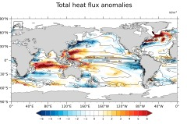
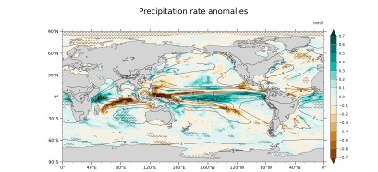
Impact of Tropical Cyclone Wind Forcing on the Global Climate in a Fully Coupled Climate Model
Li, H., A. Hu, G. A. Meehl, N. Rosenbloom, W. G. Strand (2022).
Journal of Climate 1–40. https://doi.org/10.1175/jcli-d-22-0211.1
OBJECTIVE
To investigate the impacts of tropical cyclone (TC) winds on the global ocean and the associated feedbacks in the climate system.
a
b
Tropical cyclone induced climatological changes in (a) upper 1000 m ocean heat content (unit: J), (b) SST (unit: ˚C), (c) total surface heat fluxes (unit: W/m2) and (d) precipitation rate(unit: mm/h).
APPROACH
We impose TC winds extracted from the TC-permitting high-resolution (0.25° atmosphere and 1° ocean) model simulation into a fully coupled lower-resolution model (1° atmosphere and 1° ocean) and diagnose the impact of TC wind forcing on various aspects of the coupled dynamic system.
c
d
IMPACT
Understanding TCs’ feedbacks to the large-scale climate is important for restricting climate prediction uncertainties across various time scales. We investigate the impacts of TC wind forcing on the global ocean and the associated feedbacks within the climate system using the fully coupled Community Earth System Model version 1.3 (CESM1.3). We conduct a suite of sensitivity experiments by inserting TC winds extracted from a high-resolution TC-permitting simulation into the low-resolution model. We found that the added TC winds can increase ocean heat content by affecting ocean vertical mixing, air–sea enthalpy fluxes, and cloud amount. The added TCs can influence mean SST, precipitation, ocean subsurface temperature, and ocean mixed layer depth. We found a strengthening of the wind-driven subtropical cells and a weakening of the Atlantic meridional overturning circulation. TCs in the model cause anomalous equatorward ocean heat convergence in the deep tropics and an increase of poleward ocean heat transport out of the subtropics. Our modeling results provide new insights into the multiscale interactions between TCs and the coupled climate system.

