Slide 1
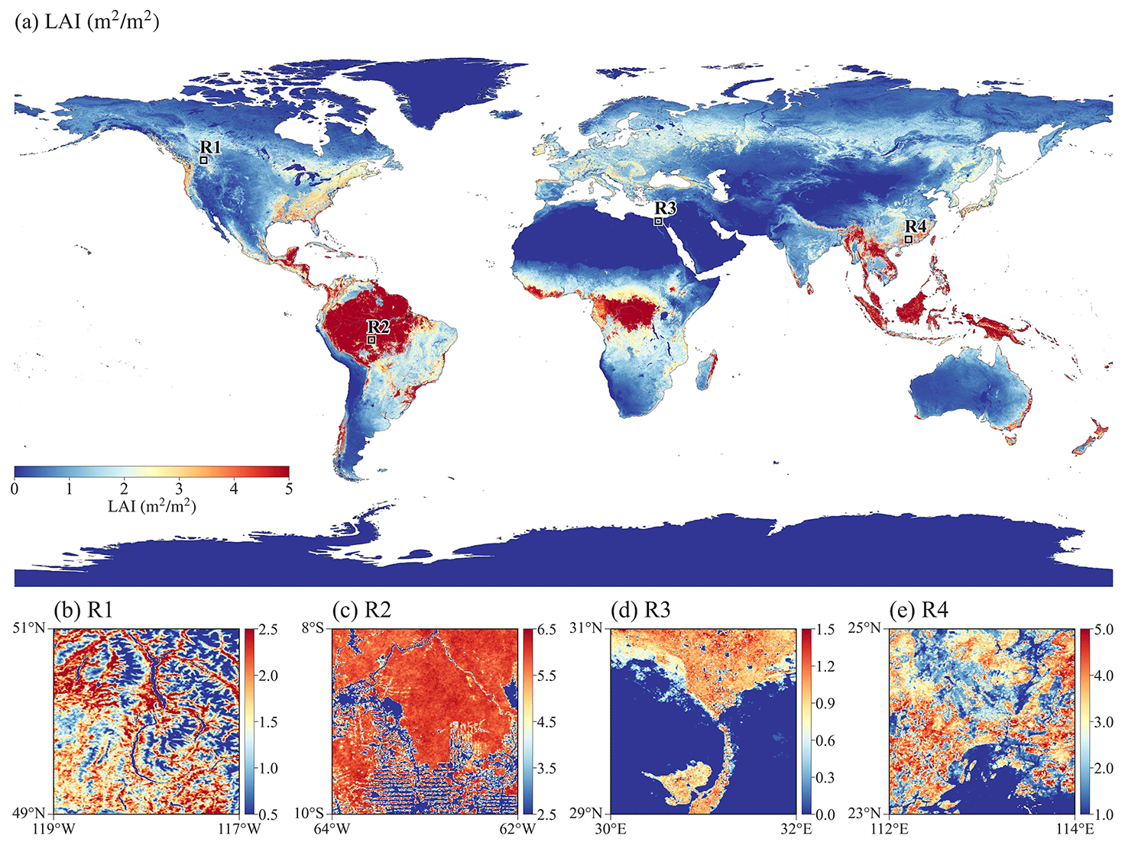
High-Resolution Land Surface Dataset Provides Earth System Modeling Details
Objective
Develop a new set of global land surface parameters with a resolution of 1 km for 2001 to 2020 utilizing the latest and most accurate datasets, including parameters of land use, vegetation, soil, and topography.
Approach
Use Google Earth Engine to process the 1 km global parameters.
Conduct 1 km resolution simulations using the Energy Exascale Earth System Model (E3SM) Land Model version 2 (ELM2) over the contiguous United States to demonstrate the capability of the 1 km parameters.
Perform spatial scaling analysis to assess the information loss by upscaling the 1 km ELM2 simulation to 12 km resolution.
Employ eXplainable Machine Learning (XML) to identify key factors driving spatial variability and information loss.
Impact
Using 1 km land surface parameters significantly enhances the spatial heterogeneity of water and energy in the ELM2 simulations.
XML methods identified the influential factors driving spatial variability and information loss, highlighting the impact of different land surface parameters.
The new parameters meet the emerging needs of k-scale Earth system modeling, potentially advancing our understanding of water, carbon, and energy cycles under global change.
The spatial pattern of leaf area index (LAI) over (a) global land and (b–e) four subregions R1–R4 within 2° boxes marked in (a). Subregions R1–R4 represent heterogeneity in topography, deforestation, agriculture, and urbanization.
Li, L., Bisht, G., Hao, D., and Leung, L. R.: Global 1 km land surface parameters for kilometer-scale Earth system modeling. Earth Syst. Sci. Data, 16, 2007–2032 (2024). [DOI: 10.5194/essd-16-2007-2024]

