Slide 1
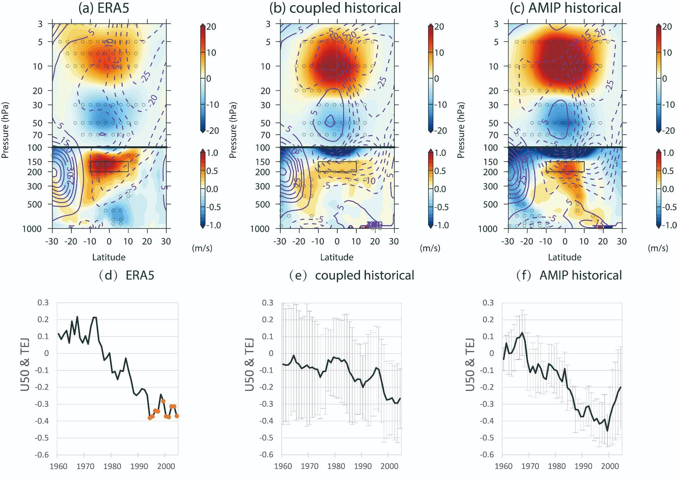
A Strengthened Teleconnection of the Quasi-Biennial Oscillation and Tropical Easterly Jet in the Past Decades in E3SMv1
OBJECTIVE
To verify and explain the strengthened teleconnection of the quasi-biennial oscillation (QBO) and tropical easterly jet (TEJ) found in reanalysis data by utilizing E3SMv1
APPROACH
We compare the Coupled Model Intercomparison Project coupled historical simulations (CMIP-historical) and the Atmospheric Model Intercomparison Project historical simulations (AMIP-historical) generated by E3SMv1 with ERA5 reanalysis data over the period of 1950-2014. The external forcings are same in CMIP-historical and AMIP-historical, except that AMIP-historical is driven by observed SST. The comparison between the AMIP-historical and coupled-historical implies that the increased SST over the Indian Ocean is likely to be one of the most important factors driving a strengthened QBO-TEJ teleconnection in the past decades.
IMPACT
We find that E3SMv1 can capture the teleconnection between the QBO and TEJ. A strengthened teleconnection between the QBO and TEJ in the past decades can be detected not only in observation but also in the model. The warming in sea surface temperatures over the Indian Ocean and opposite trends in the air temperature in the upper troposphere and lower stratosphere are considered the essential reasons responsible for this strengthened teleconnection.
Modified Figure 1:
The anomalies of zonal wind (filled color) at the tropical easterly jet longitude (upper row) in boreal summer (June to August) correspond to EQBO.The purple contour lines represent the climatological mean.The regions with dots in the upper row are significant at the 90% confidence level. The box region is between 10°N–10°S and 150–200 hPa to define TEJ index. In the bottom row is the 21-year running correlations between the tropical easterly jet intensity averaged in the black box and the QBO index at 50 hPa.
Li, Y., Richter, J. H., Chen, C.-C., & Tang, Q. (2023). A strengthened teleconnection of the quasi-biennial oscillation and tropical easterly jet in the past decades in E3SMv1. Geophysical Research Letters, 50, e2023GL104517. https://doi.org/10.1029/2023GL104517

