Slide 1
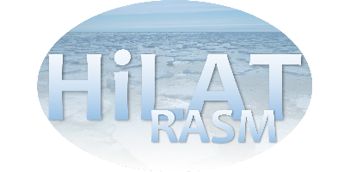
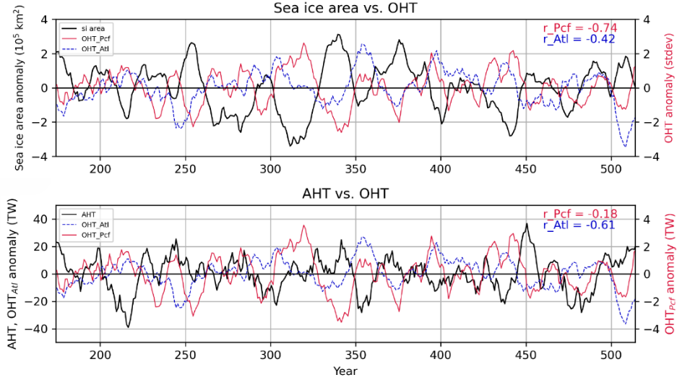
Bering Strait Ocean Heat Transport Drives Decadal Arctic Variability in a High-Resolution Climate Model
Objective
Explore the impact of ocean heat transport (OHT) through the Bering Strait (North Pacific) and across the Greenland-Scotland Ridge (North Atlantic) on Arctic atmosphere and sea ice.
Research
We analyze a 500-year pre-industrial control integration with a high-resolution configuration of the Community Earth System Model (CESM1.3).
We regress ocean heat transport time series on several atmosphere and sea ice quantities.
We analyze the atmosphere energy budget in response to OHT variability from the North Pacific and North Atlantic Oceans.
Impact
We demonstrate that OHT from the Pacific through the Bering Strait has a stronger impact on the Arctic atmosphere and sea ice than OHT from the Atlantic.
The ice-albedo feedback strongly amplifies the impact of OHT through Bering Strait.
OHT transport variability on the Atlantic side only is compensated by opposing anomalies in atmospheric heat transport (Bjerknes Compensation).
Ocean heat transport (OHT) from the Pacific into the Arctic Ocean through the Bering Strait (red curves) has a stronger impact on Arctic surface temperatures and pan-Arctic sea ice extent (top) than OHT from the Atlantic Ocean across the Greenland-Scotland Ridge (blue). In contrast, the latter is strongly anti-correlated with atmospheric heat transport (bottom), suggesting that Atlantic OHT variability is compensated by the atmosphere (Bjerknes Compensation).
Li, Y., Weijer, W., Kurtakoti, P., Veneziani, M. and Chang, P., 2024. Bering Strait ocean heat transport drives decadal Arctic variability in a high‐resolution climate model. Geophysical Research Letters, 51(12), p.e2024GL108828. doi: 10.1029/2024GL108828

