Slide 1
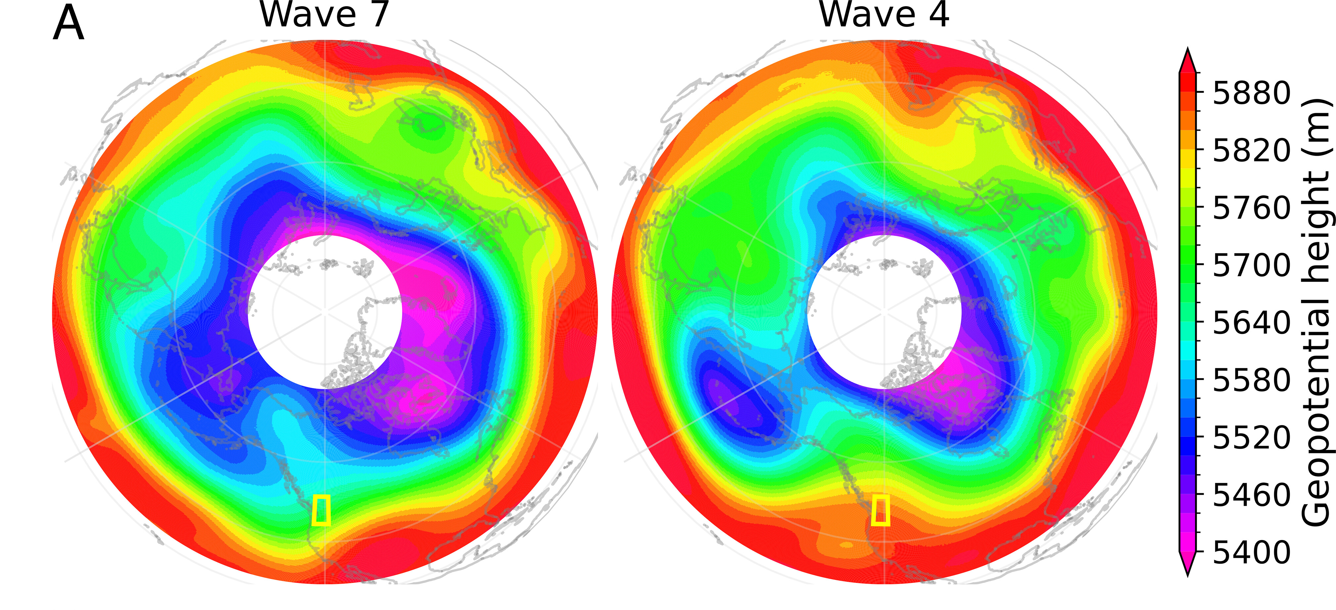

Role of atmospheric resonance and land–atmosphere feedbacks as a precursor to the June 2021 Pacific Northwest Heat Dome event
We demonstrate a combination of factors contributed to the singularly anomalous Pacific Northwest Heat Dome event of summer 2021, involving the phenomenon of resonant planetary wave amplification—not well represented in state-of-the-art climate models—which interacted with land surface feedbacks to catalyze the extreme heat event.
Neglecting preconditioning feedback mechanisms in climate model analyses could potentially cause underestimates in the future likelihood or severity of extreme continental heat waves. Our findings hold the potential for more skillful predictions of low-probability yet impactful weather extremes that can have devastating consequences.
Wave patterns during the record-shattering heat wave at different stages. Polar stereographic projection of 500 hPa geopotential height fields (m) averaged over the wave 7 and wave 4 regimes characterized in this study, respectively. The yellow box indicates the PNW region.
We find that there was an interplay between a persistent, amplified large-scale atmospheric circulation state and soil moisture feedbacks as a precursor for the June 2021 Pacific Northwest “Heat Dome” event. An extended resonant planetary wave configuration prior to the event created an antecedent soil moisture deficit that amplified lower atmospheric warming through strong nonlinear soil moisture feedbacks, favoring this unprecedented heat event.
Xueke Li, Michael E. Mann, Michael F. Wehner, Stefan Rahmstorf, Stefan Petri, Shannon Christiansen, Judit Carrillo (2024) Role of atmospheric resonance and land-atmosphere feedbacks as a precursor to the June 2021 Pacific Northwest “Heat Dome” event. Proceedings of the National Academy of Science. 121 (4) e2315330121

