Slide 1
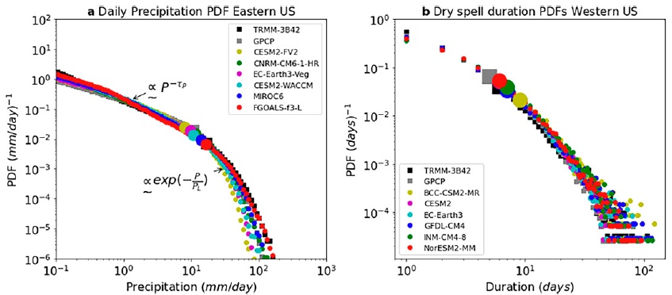
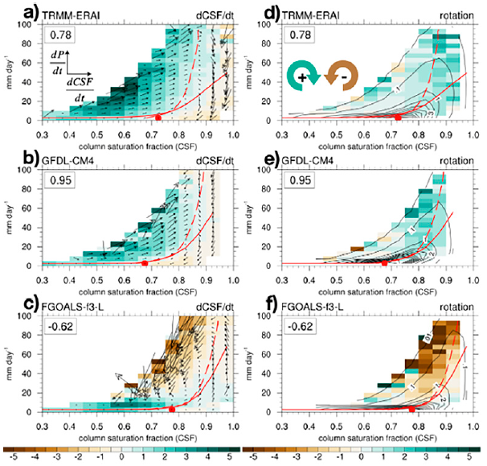
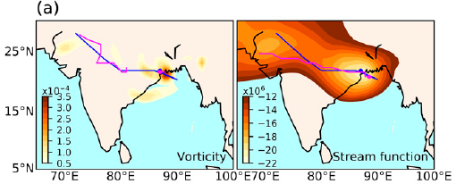
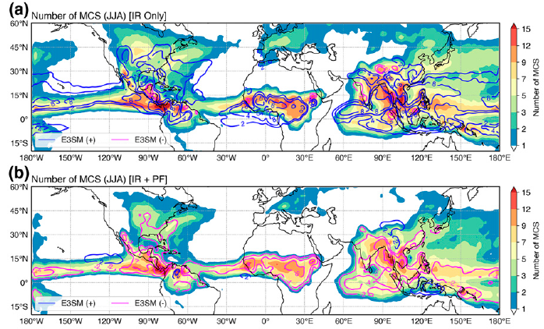
Testing a Suite of Exploratory Precipitation Metrics for Improving Precipitation Modeling
Extreme precipitation and dry spells
Objective
Demonstrate the use of new metrics and diagnostics to connect model precipitation errors to their sources for broader use by the weather and climate modeling community.
Approach
Select a suite of precipitation metrics and diagnostics focusing on precipitation spatiotemporal characteristics, precipitation environments, and precipitation associated with weather phenomena.
Apply the metrics/diagnostics to climate simulations in phases 5 and 6 of the Coupled Model Intercomparison project.
Identify model skill in simulating various aspects of precipitation as revealed by the metrics and analyze possible relationships among the different metrics.
Impact
Demonstrated the usefulness of the diverse set of metrics for benchmarking model precipitation against observations.
Motivated a coordinated effort to implement the metrics in community diagnostic packages to facilitate broader use by the weather and climate modeling community.
Rainfall-moisture coupling
Low-pressure systems
Mesoscale convective systems
Examples of precipitation metrics benchmarking the Coupled Model Intercomparison project simulated precipitation against observations.
Leung, L.R., et al. “Exploratory Precipitation Metrics: Spatiotemporal Characteristics, Process-Oriented, and Phenomena-Based.” J. Clim., 35, 3659-3686, (2022). [doi:10.1175/JCLI-D-21-0590.1].

