Slide 1
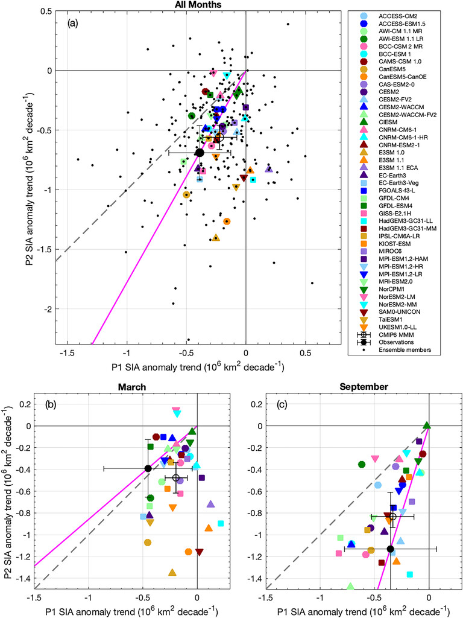
Assessment of the Pan-Arctic Accelerated Rate of Sea Ice Decline in CMIP6 Historical Simulations
Objective
Evaluate the CMIP6 models’ ability to represent the observed acceleration in the Arctic sea ice decline.
Propose a more rigorous evaluation method for qualifying sea ice model skill and explore potential causes of the accelerated sea ice decline.
Research
We assessed Arctic sea ice loss in response to a warming climate in 42 CMIP6 models.
We quantify CMIP6 accelerated trends of Arctic sea ice area and volume decline from historical simulations and compare them against observationally derived trends and acceleration.
We evaluate causality between increasing ocean northward heat transport and sea ice decline in CMIP6 ensembles.
Impact
We find that quantifying the CMIP6 historical accelerated sea ice trends is challenging due to limited observational constrains and large internal variability among individual simulations.
We introduce an emergent constraint that relates trends in ocean heat transport to those in Arctic sea ice cover under a warming climate.
We propose a new model metric involving the examination of OHT and its impact on sea ice decline to reduce uncertainties associated with the ice-ocean feedback.
SIA anomaly trends for the periods 1979–96 (P1 on the x axis) and 1997–2014 (P2 on the y axis) for the combined passive microwave observations and CMIP6 models with ensemble members (black dots) as well as the MMM. Error bars indicate a 95% confidence interval for each period. The solid magenta line illustrates the observed SIA acceleration ratio [slope of P2/P1 = (a) 1.78, (b) 0.86, and (c) 3.18], and the gray dashed line illustrates an acceleration ratio of 1.
Lee, Y. J., M. Watts, W. Maslowski, J. C. Kinney, and R. Osinski, 2023: Assessment of the Pan-Arctic Accelerated Rate of Sea Ice Decline in CMIP6 Historical Simulations. J. Climate, 36, 6069–6089, https://doi.org/10.1175/JCLI-D-21-0539.1.

