Slide 1
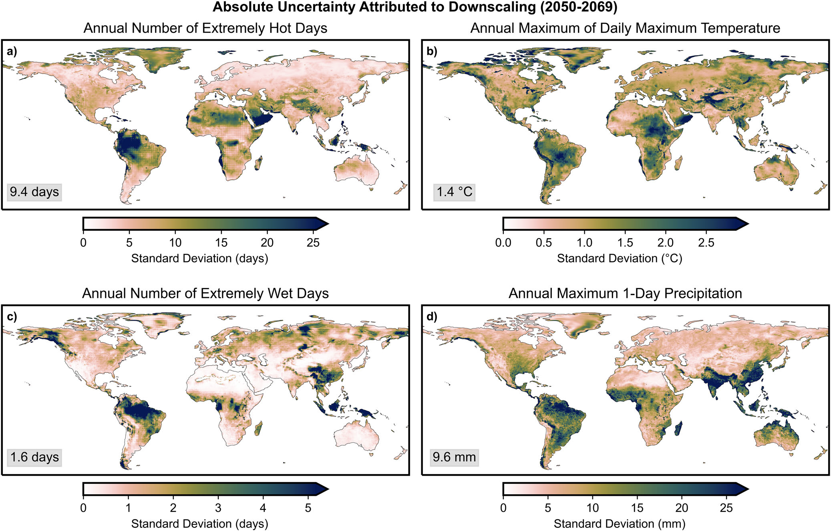
Downscaling and bias-correction contribute considerable uncertainty to local climate projections in CMIP6
Objective
Accurate climate projections, which are critical for managing local climate risks, are typically based on ensembles of global circulation models (GCMs). As such, it is important to understand the large uncertainties that can arise from the selection of climate scenarios, GCMs, and downscaling and bias correction algorithms.
Approach
To quantify the contribution of downscaling and bias-correction to global projection uncertainty for a variety of climate metrics, we employ a variance decomposition approach that accounts for four sources of uncertainty.
Impact
Substantial heterogeneity in the uncertainty partitioning is evident across regions, timeframes, and climate metrics, but downscaling and bias-correction typically contribute at least 25% of the total projection uncertainty. Considering downscaling uncertainty is particularly important over the near term, in projections of precipitation or temperature extremes, and in regions of observational disagreement.
Figure 1: The contribution of downscaling to absolute uncertainty. Absolute uncertainty attributed to downscaling, averaged over 2050–2069, for: a) annual number of extremely hot days, b) annual maximum of daily maximum temperature, c) annual number of extremely wet days, and d) annual maximum 1-day precipitation. The absolute uncertainty is expressed via the standard deviation across ensembles at each grid point and is measured in physically meaningful units. The gray boxes in the lower left of each subplot give the area-weighted global average of each contribution.
Lafferty, D.C., Sriver, R.L. Downscaling and bias-correction contribute considerable uncertainty to local climate projections in CMIP6 (2023). npj Climate and Atmospheric Science 6: 158. https://doi.org/10.1038/s41612-023-00486-0

