Slide 1
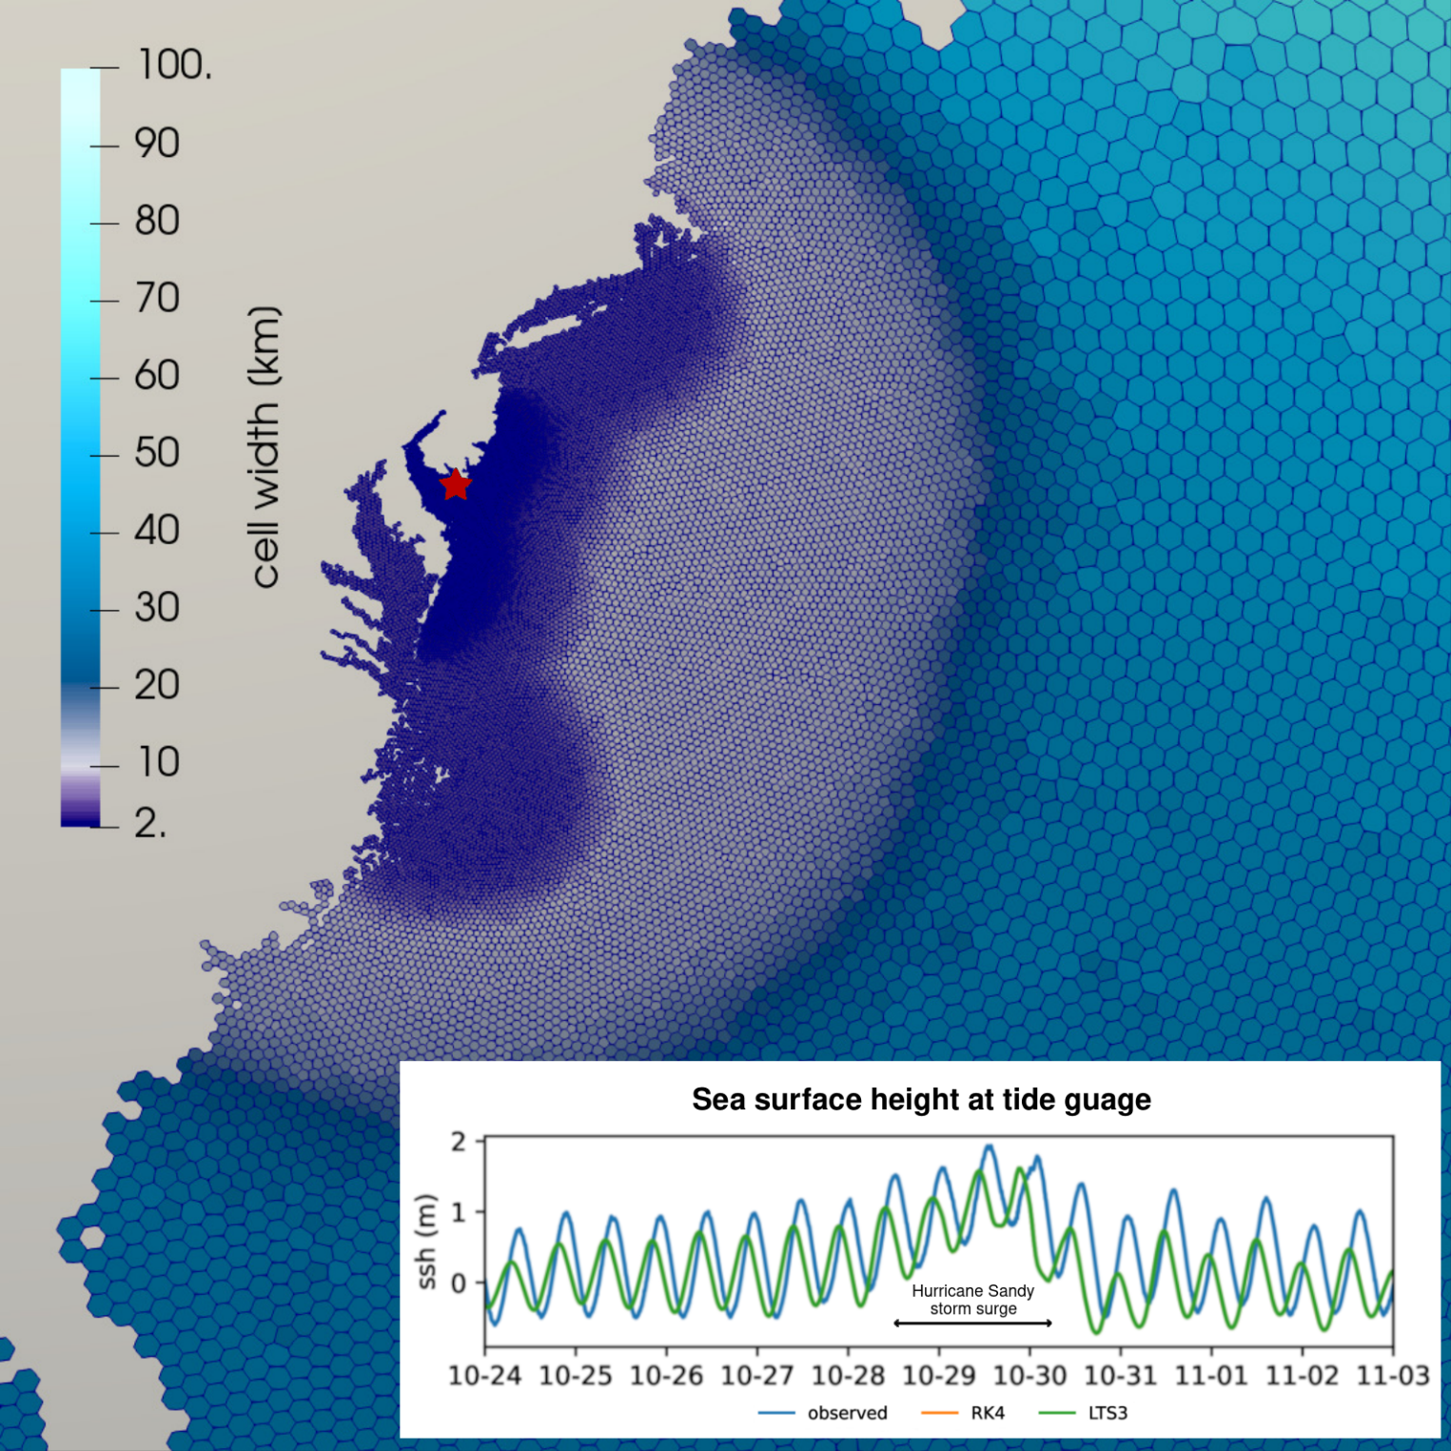
Faster Storm Surge Modeling with Local Time-Stepping
Objective
Evaluate the efficiency and efficacy of local time-stepping (LTS) methods in the Model for Prediction Across Scales-Ocean (MPAS-Ocean).
Approach
Model the storm surge around Delaware Bay caused by Hurricane Sandy in 2012.
Run MPAS-Ocean using both LTS and a standard global time-stepping method, the classical four-stage, fourth-order Runge-Kutta method (RK4).
Document the total computing time for both cases and compare model solutions.
Impact
The LTS methods produce solutions of comparable quality to the RK4 higher-order scheme up to 35% faster.
These results provide guidance on efficient mesh design requirements. For LTS to be efficient on a given mesh, the ratio of cells using the coarse time-step compared to the number of cells using the fine time-step is important and should be at least 1:5.
LTS achieves the best performance increases when the ratio of cells using the coarse time-step versus cells using the fine time-step is at least 1:1.
LTS produces model solutions of comparable quality to a standard global scheme up to 35% faster. The image shows the different sized grid cells, which are substantially smaller near the coastline. The inset shows the model results compared to observations. The LTS scheme produces results that are similar in accuracy to a more computationally expensive, state-of-the-art global time-stepping scheme.
Lilly, J. R., et al. “Storm surge modeling as an application of local time-stepping in MPAS-Ocean,” Journal of Advances in Modeling Earth Systems, 15, e2022MS003327 (2023). [DOI: 10.1029/2022MS003327]

