Slide 1

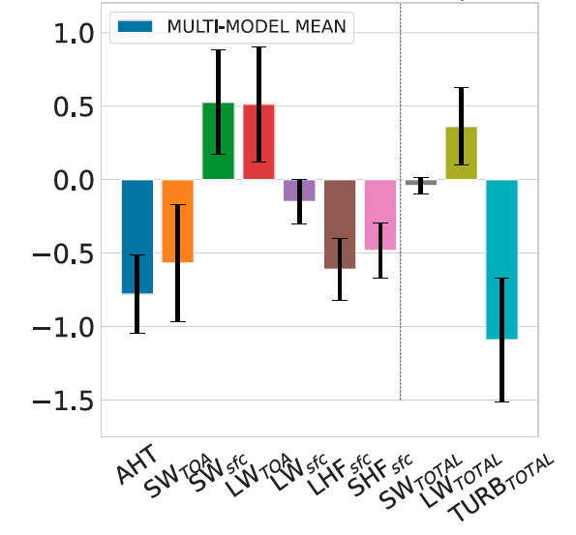
Sea Ice and Clouds Mediate Compensation between Atmospheric and Oceanic Meridional Heat Transports
Objective
Changes in poleward ocean heat transport tend to be partly compensated by opposing changes in atmospheric heat transport, a process referred to as Bjerknes Compensation (BjC).
We study BjC in the CMIP6 ensemble to better understand the processes responsible for BjC and their representation in Earth system models.
Research
We analyze BjC in an ensemble of 18 CMIP6 models.
We calculate regressions between ocean heat transport (OHT) across 65°N, and the fluxes that contribute to atmospheric heat transport (AHT).
We particularly consider shortwave, longwave, and turbulent flux contributions to the atmospheric heat transport across 65°N.
Impact
We demonstrate that the ice-albedo feedback is a key process boosting BjC in CMIP6 models.
The model spread in sea ice cover explains the spread in Bjerknes Compensation in CMIP6 models.
Cloud feedbacks play a secondary role.
Improved understanding of the processes that lead to BjC will help us better predict the response of the Arctic to expected increases in poleward ocean heat transport.
Schematic (left) and multi-model mean (right) show the contributions of different processes to BjC, which is the compensation of ocean heat transport (OHT) anomalies by opposing anomalies in atmospheric heat transport (AHT). Latent (LHF) and sensible (SHF) heat fluxes transfer heat from the ocean to the atmosphere and are the primary source of BjC. Shortwave fluxes (SW) due to the ice-albedo feedback amplify BjC while longwave fluxes (LW) dampen BjC.
Kurtakoti, P., W. Weijer, M. Veneziani, P. J. Rasch & T. Verma (2024). Sea Ice and Cloud Processes Mediating Compensation between Atmospheric and Oceanic Meridional Heat Transports across the CMIP6 Preindustrial Control Experiment. J. Clim., 37, 505-525. doi: 10.1175/JCLI-D-23-0103.1

