Slide 1
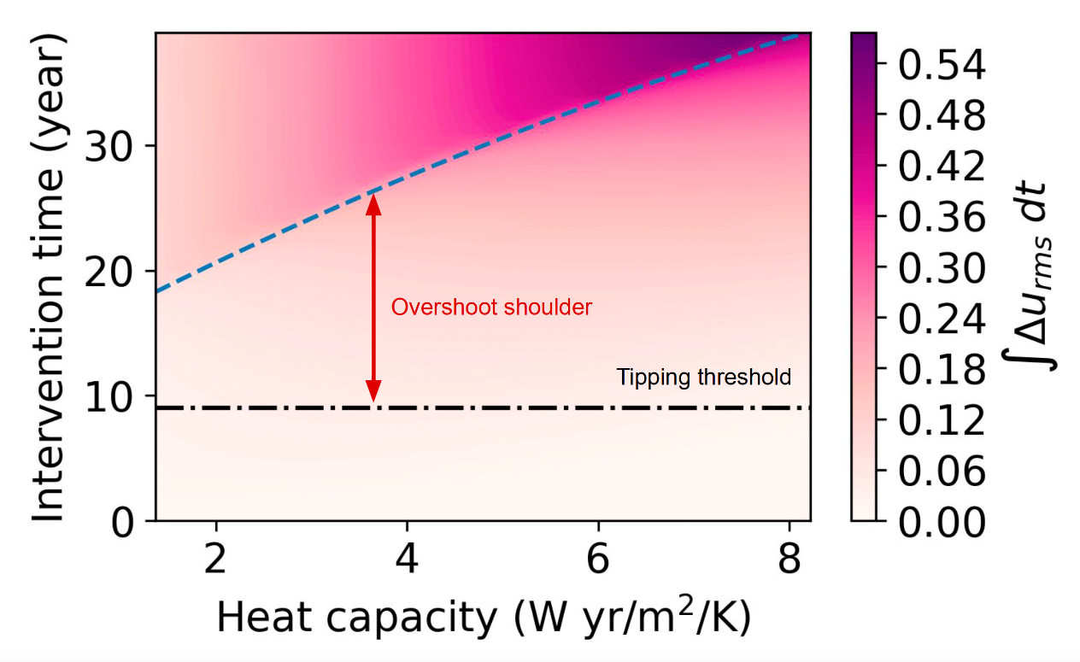
Modeling a Control Strategy to Reverse Sea-Ice Loss Near its Tipping Point
Objective
This study sought to investigate whether a climate element near its tipping threshold can be optimally controlled and stabilized.
Approach
Used variational methods to devise an optimal control scheme to stabilize sea-ice in an idealized climate model while minimizing the cost of applying this scheme.
Studied the dependence of control measures on important features of the tipping point, such as the critical threshold and the strength of hysteresis.
Explored the impact of possible delay in the onset of tipping due to system inertia.
Impact
We found quantitative confirmation that preventive measures are less costly and intrusive than post-tipping corrective interventions.
While thermal inertia may delay tipping, leading to an overshoot of the critical threshold, this leeway comes with a steep rise in requisite control once tipping occurs.
The approach developed in this study is adaptable to other models and could apply to other tipping elements due to the ubiquitous underlying mathematical structure of tipping.
The contour plot above shows the variation in the control required to reverse sea-ice loss with the time of intervention (y-axis) and increase in heat capacity (x-axis). Our studies show that system inertia due to large ocean heat capacity allows for an overshoot window past the tipping threshold (dash-dotted line) during which the requisite control only scales linearly with the intervention time. Past this shoulder (dashed line), there is a steep rise in the requisite control, as indicated by the darker shade. Increased system inertia leads to more leeway; however, this is accompanied by a steeper change in control costs once the window is crossed.
Kooloth, P., Lu, J., Bakker, C. et al. Optimal control of polar sea-ice near its tipping points. npj Clim Atmos Sci 7, 274 (2024). https://doi.org/10.1038/s41612-024-00768-1
Notes:
http://www.pnnl.gov/science/highlights/highlights.asp?division=749

